Slide 1
Unit 74: Computer Game Story Development

Slide 2
Aim and purpose
1 Understand the elements of storytelling for games
2 Be able to create story for a game following industry practice
3 Be able to create game dialogue following industry practice.

Slide 3
What is a story
A story is first of all a chain of events that begins at one place and ends at another
A tale shall accomplish something and arrive somewhere.

Slide 4
Games are interactive stories
Stories that the player interacts with by contributing actions to them.
A story can be interactive even if the players action cannot change the overall direction of the plot.

Slide 5
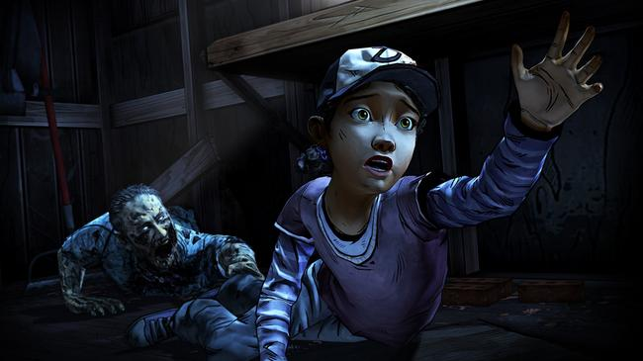
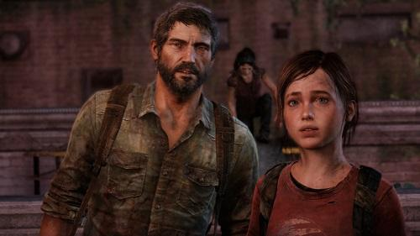
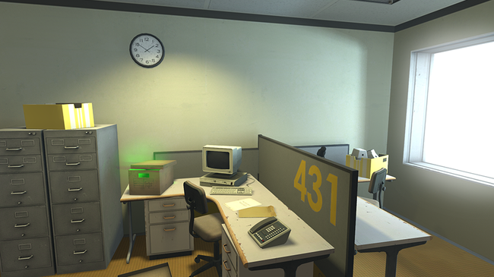
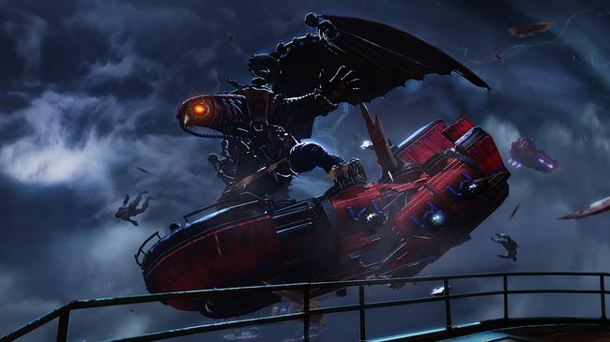
Example games
Notes:
https://www.pcmag.com/feature/317795/the-top-10-interactive-games-for-story-lovers/5

Slide 6
Narratives in games
Narrative is the way in which the story is told
The easy way to remember the difference between story and narrative is to reshuffle the order of events. A new event order means you have a new narrative of the same story.

Slide 7
Narratives in games
Narrative is developed in ‘storyplay’ – the mingling of storytelling and gameplay which allows players influence over both what the story is about and how that story is experienced.
Good game writers can produce complex narratives which anticipate the way interactivity and non-linearity will affect a user’s experience of their story.

Slide 8
Why create gaming narratives
Well rounded characters are expected by the modern game player
Full characterisation encourages that suspension of disbelief which enables immersion in the game and contributes to the success of the title.
In many games, the player experiences what the main character experiences during the course of the story.
Character development through ‘backstory’ provides the characterisation so important to modern game development and adds to the realism of the game.

Slide 9
Meet the game makers - story
https://youtu.be/OGtFHopRpNY

Slide 10
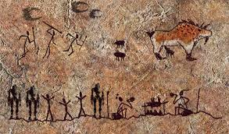
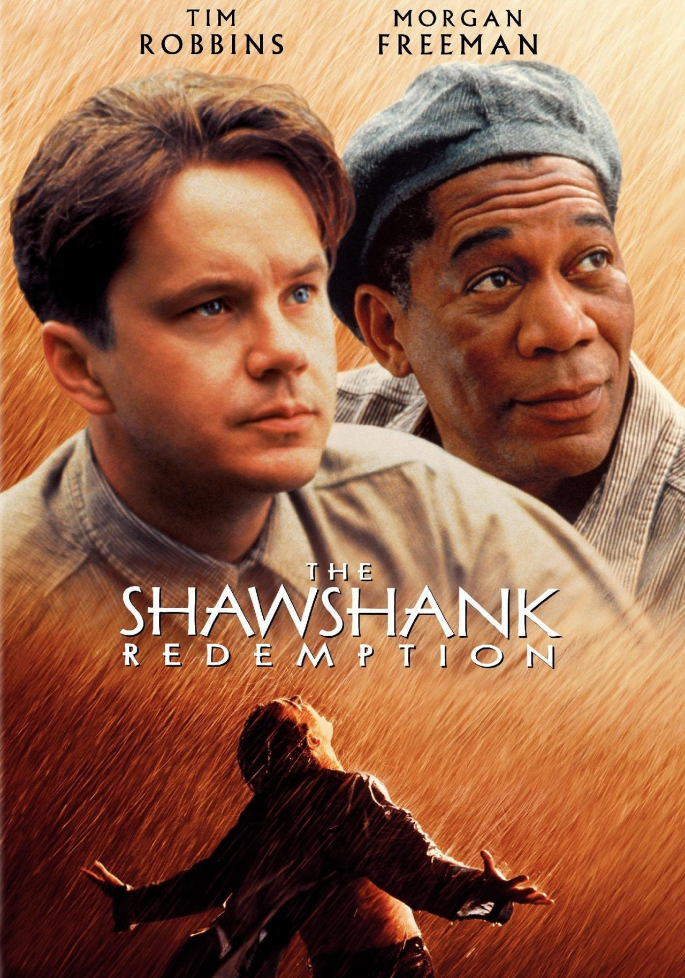
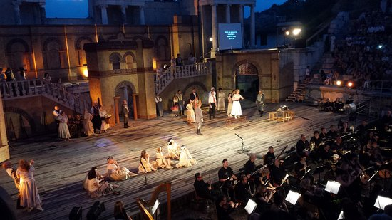
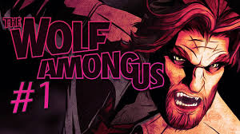
Forms of storytelling
Cave painting
Oral traditions (fable, myth, legend)
Theatre
Text
Film
Television
Games!
Notes:
Fable: a short tale to teach a moral lesson, often with animals or inanimate objects as characters; apologue: Not founded in fact
Myth: a traditional story, especially one concerning the early history of a people or explaining a natural or social phenomenon, and typically involving supernatural beings or events. A widely held but false belief or idea.
Legend: a traditional story sometimes popularly regarded as historical but not authenticated.

Slide 11
Task: Tell a story without words
Imagine you are now entering the ancient world. It is 12000BC and Britain is beginning to warm after the Ice Age.
You live a hunter-gatherer life, hunting mammals such as reindeer and Arctic hare.
Choose one member of the group to be the ‘messenger’ – they will have to share a message with the rest of the group by drawing a picture.
The messenger can make up their own ancient message or use one of mine.
Notes:
Ancient messages could be:
• I have had a successful hunt today and killed a deer.
• There are many fish in the river over the big hill.
• I have found a new cave that we could shelter in to keep dry.
• Has anyone seen my caxe?

Slide 12
Task: Tell a story without words continued
Don’t worry if you haven’t worked out the message completely once the time is up.
The aim of this game is to show just how tricky it must have been to communicate and share stories without written language.
This may be why some ancient people began to use art to describe the world around them

Slide 13
Game genres
Action, eg platformers, first-person shooter (FPS), third-person shooter (TPS)
Racing
Fighting
Adventure
Puzzle
Role-play;
role-playing;
simulation and sports, eg turn-based strategy (TBS), real time strategy (RTS)

Slide 14
Task: Find 5 games that have stories for each of the genres
Action, eg platformers, first-person shooter (FPS), third-person shooter (TPS)
Racing
Fighting
Adventure
Puzzle
role-playing;
simulation and sports, eg turn-based strategy (TBS), real time strategy (RTS).

Slide 15
TASK: Short story inspired by…
Pick a game that contains little or no story.
Create a short story for it
Examples include:
Tetris
Minecraft
Pac Man
Rainbow Six: Siege
Overwatch
Include:
An over-arching plot
Beginning, middle and end
At least one character (try to stretch yourself and your ideas to consider character interaction, this can be with another character or their environment

Slide 16
Components of story
Notes:
Group A

Slide 17
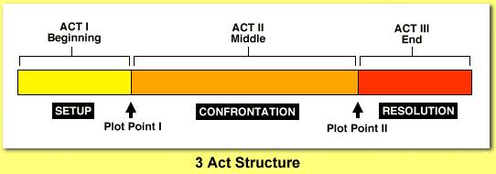
Approaches: three-act structure
Act 1: Beginning, Equilibrium, Exposition, Setup
Act 2: Middle, Disruption, Confrontation, Rising action
Act 3: End, Resolution, Something has changed about the world or characters

Slide 18
Approaches
Location
Conditions
Actions

Slide 19
Approaches: Symbolism
Symbolism is everywhere; symbolism exists whenever something is meant to represent something else.
Symbolism is a figure of speech that is used when an author wants to create a certain mood or emotion in a work of literature.
It is the use of an object, person, situation or word to represent something else, like an idea, in literature.
Using Metaphors is a good way of adding symbolism - a comparison between two unlike things without using the words 'like' or 'as'.
Notes:
For example, the phrase 'time is money' is an example of a metaphor comparing time to money.
Money and time are two different things; this is an example of symbolism because these words show the importance of using your money and time wisely.

Slide 20
Approaches: Symbolism
The phrase 'time is money' is an example of a metaphor comparing time to money. Money and time are two different things; this is an example of symbolism because these words show the importance of using your money and time wisely.
You could use fire to represent a character with a hot temper. Running water may become a symbol for purification. Illness might represent sin or corruption.

Slide 21
Approaches: Symbolism
Often, strong metaphoric language will emerge naturally while writing a story. In the rewriting, see if you can identify any recurring motifs that crop up.
Can you strengthen them to better represent your theme?
Try to figure out ways to use different aspects of the same motif to describe varying characters.

Slide 22
Approaches: Symbolism
The cake from the game Portal is a perfect example of a symbol
This cake starts of as a symbol of success and future rewards.
This was later on revealed to be a false promise. A lie.
After this drama, it became the symbol of GLaDOS’ betrayal.
Notes:
Hence, it wasn’t a fictional character who was betrayed. It was you, the gamer who was. We were promised cake, but we didn’t get any!

Slide 23
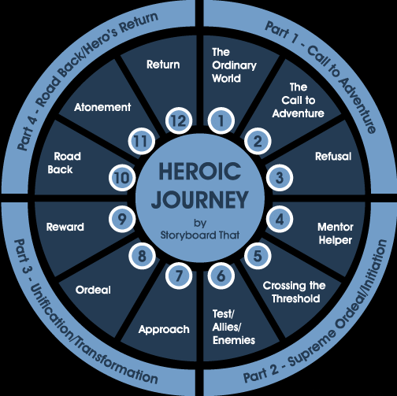
Approaches: A Hero's journey
Describes the typical adventure of the archetype known as The Hero, the person who goes out and achieves great deeds on behalf of the group, tribe, or civilization.
Most commonly used within RPG’s

Slide 24
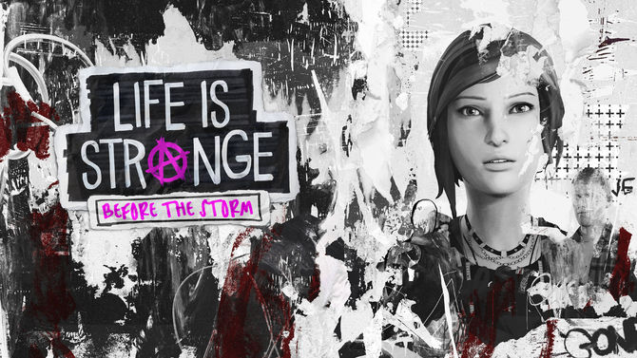
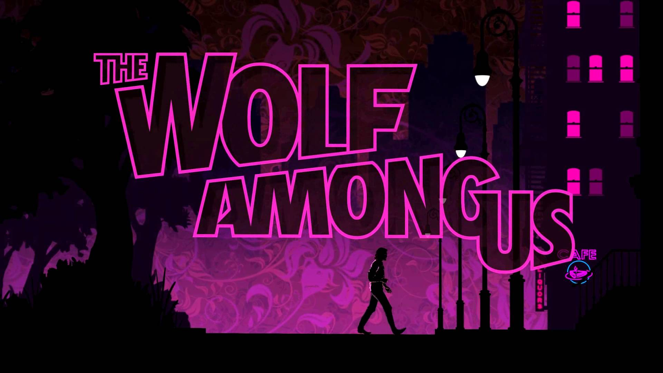
Approaches: episodic
Examples of episodic video games include most Telltale games, Alan Wake, BioShock Infinite: Burial at Sea, Grand Theft Auto: Episodes from Liberty City, Life Is Strange, Resident Evil Revelations, Revelations 2, and Star Trek Online.

Slide 25
Approaches: episodic
Shorter in length and commercially released as an installment to a continuous and larger series.
Differ from conventional video games in that they often contain less content but are developed on a more frequent basis.
Such a series may or may not have continuity, but will always share settings, characters, and/or themes.
Increasingly popular among video game developers since the advent of low-cost digital distribution systems, which can immensely reduce their distribution overhead and make episodes financially viable.
Alternatively, it can be used to describe the narrative of the game.

Slide 26
Story Approaches: Task
Discuss and blog how story is approached in 3 story driven games you have played. Think about the components of the story:
Plot and the events that take place
Narrative – Including central and subplots
Characters – their ally's, opponents, lover/mate
Theme and Symbolism
3 act structure - Explain
Traditional or episodic
Location
Conditions
Actions

Slide 27
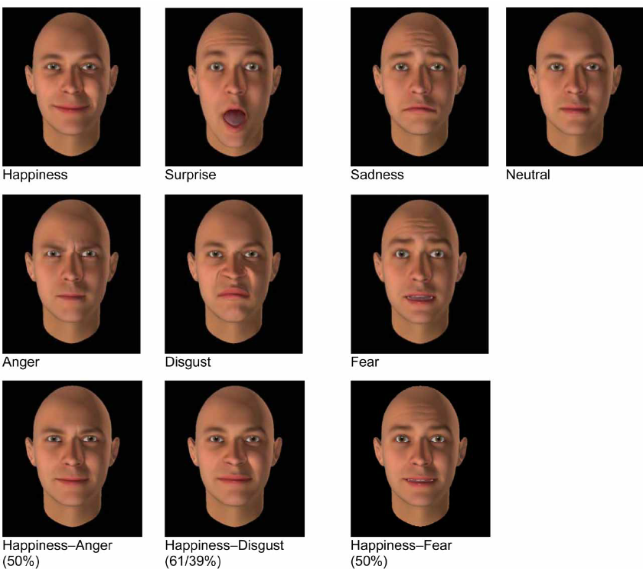
Representation: emotions
-How are the emotions of characters shown in the game?
Visually through the models and animation we create:

Slide 28
Representation: emotions
-How are the emotions of characters shown in the game?
Anger: Produced with a lower pitch, higher intensity, more energy.
Disgust: Produced with a lower, downward directed pitch, with energy
Fear: Fear can be divided into two types: "panic" and "anxiety". In comparison to neutral speech, fearful emotions have a higher pitch, little variation, lower energy, and a faster speech rate with more pauses.
Sadness: In comparison to neutral speech, sad emotions are produced with a higher pitch, less intensity but more vocal energy, longer duration with more pauses.
Audibly through voice.
characterized through tone of voice, pitch, loudness, speech rate, and pauses

Slide 29
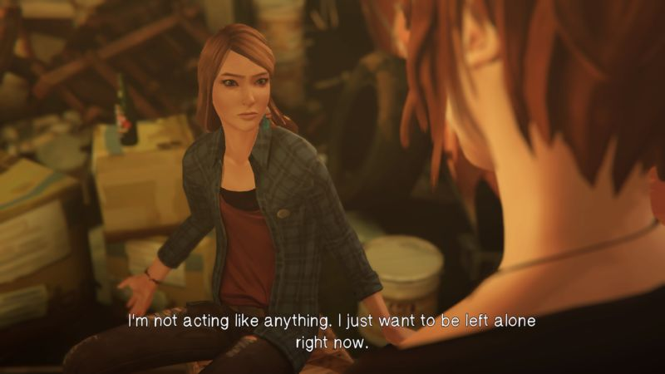
Representation: characterization
What is charactersation?
The creation or construction of a fictional character.
Good characterization:
Show the player directly what a character's personality is like.
Portray a character's thoughts and motivations.
Use dialogue to allow words to reveal something important about his or her nature.
Use actions to reveal his or her personality.
Show others' reactions to the character or person you're portraying.
Give fictional characters meaningful names or use real people's nicknames that relate to their personalities.

Slide 30
Stereotypes: gender, ethnicity
50 top selling games where analysed between 2007-2012 by Ross Orlando. The quote below explores some of the issues you will consider:
“Of the 45 male characters in the games, Orlando found one-third exhibited stereotypical masculine qualities such as hyper-aggressiveness.
He notes that stereotypes of women in scant clothing and behaving in hyper-sexualized manner, and of men as muscular and hyper-aggressive, are the same stereotypes seen in other media, such as movies or comics. “This helps perpetuate the dominant narrative of ‘how men and women should be,'” he writes in his paper.”
Read more at: http://phys.org/news/2014-06-racial-gender-representation-video-games.html#jCp
http://en.wikipedia.org/wiki/Gender_representation_in_video_games
http://www.hastac.org/blogs/ezobel/2014/03/06/damsels-distress-female-representation-video-games

Slide 31
Stereotypes: ethnicity
He also notes on ethnicity:
Racial diversity is lacking in these games, as well. Black and Asian characters each have 3 percent representation in the pool of main protagonists; Latino a mere 1 percent. There are no representations of Indigenous peoples among playable characters. White protagonists, on the other hand, comprise 67 percent of main characters in the games. Read more at: https://phys.org/news/2014-06-racial-gender-representation-video-games.html#jCp
http://en.wikipedia.org/wiki/Gender_representation_in_video_games
http://www.hastac.org/blogs/ezobel/2014/03/06/damsels-distress-female-representation-video-games

Slide 32
Task: Emotion and Representation
How are the emotions of characters shown in the game?
Describe the use of characterization and representation in your chosen game.
Do characters follow stereotypes of gender and ethnicity? How?
Can you give examples of games which defy conventional representation?

Slide 33
Emotional themes
Theme | Definition
VENGENCE | “Punishment inflicted or retribution exacted for an injury or wrong. “
HAPPINESS | “State of well-being characterized by emotions ranging from contentment to intense joy. “
FEAR | “Be afraid of (someone or something) as likely to be dangerous, painful, or threatening“
ANGER | “A strong feeling of annoyance, displeasure, or hostility. “
PERSEVERANCE | “Steadfastness in doing something despite difficulty or delay in achieving success. “
HEROISM | “Great bravery“
VALOUR | “Exceptional courage when facing danger (especially in battle) “
HOPE | “A feeling of expectation and desire for a certain thing to happen“
COMPETITIVENESS | “An aggressive willingness to compete“

Slide 34
Task: Emotional themes
Game stories employ themes common to many stories. Describe the use of the following themes in the game you are analyzing. If it does not feature in the game you are analysing then describe the use of it in a game that does feature it. . .
Vengeance
Happiness
fear
Anger
Perseverance
Heroism
Valour
Hope
Competitiveness

