Slide 1
Space Invaders inspired game
Unsing GameMaker

Slide 2
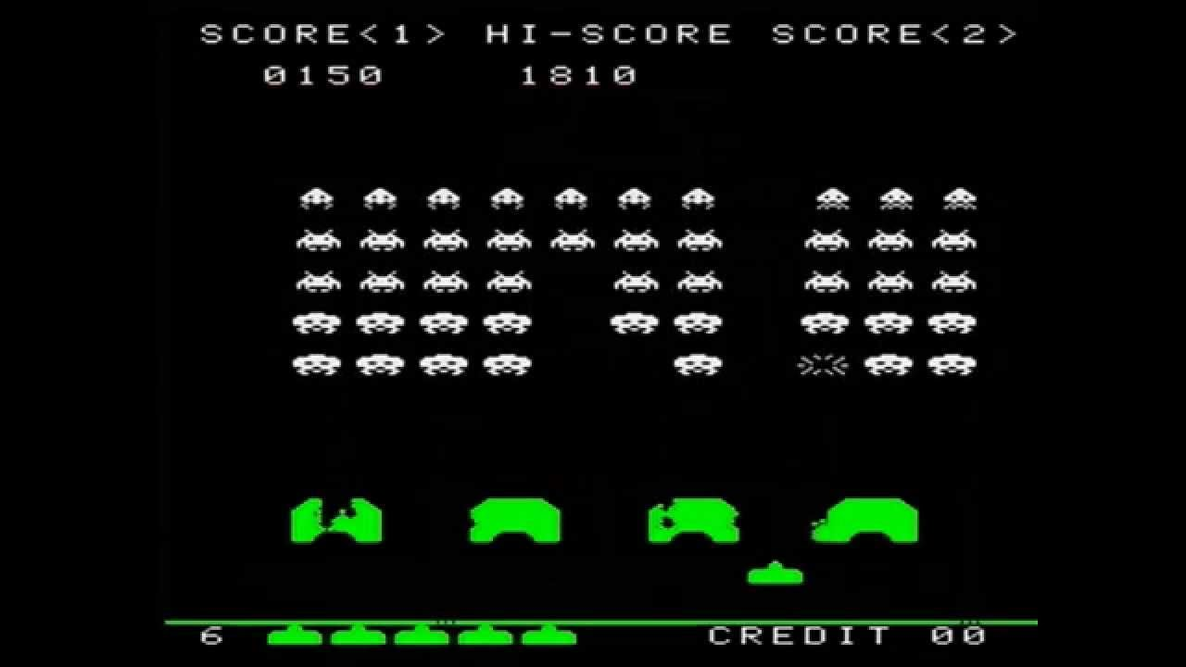
Notes:
https://www.youtube.com/watch?v=axlx3o0codc

Slide 3
Space Invaders – Sprites and objects needed
Ship - the space ship
Alien/s - enemy's to shoot and be shot by
Bullet - what the player fires at the aliens
Bomb - what the alien will drop on the player
Barricade - a green barricade to get in the way of bullets and bombs
Plus a object with no sprite called obj_control that will be used for lives and health

Slide 4
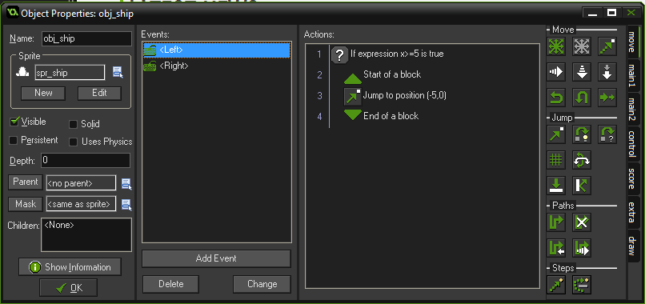
Player Movement - Left

Slide 5
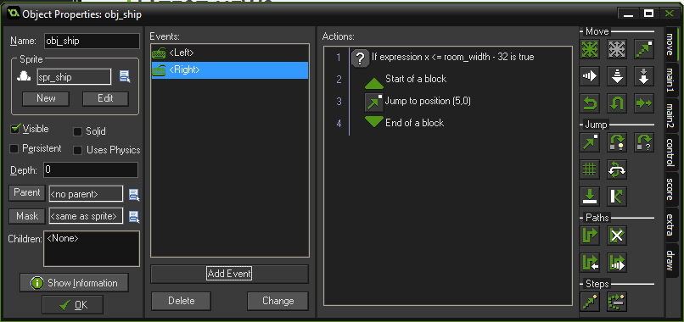
Player Movement - Right

Slide 6
Get your enemy aliens moving

Slide 7
Have then alien enemies moving left to right
Notes:
Obj_alien should be solid

Slide 8
Getting the enemies moving right to left
Notes:
Obj_alien should be solid

Slide 9
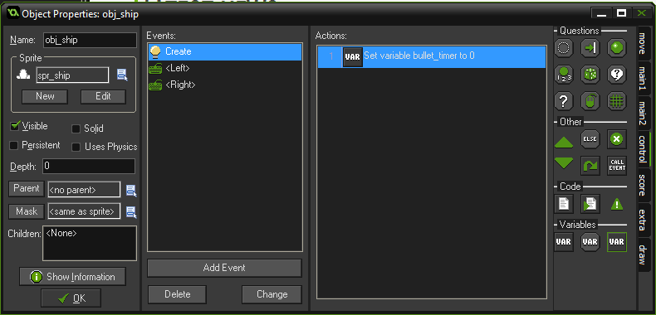
Creating a variable to stagger bullets

Slide 10
Creating a variable to stagger bullets

Slide 11
Creating the bullet

Slide 12
Getting the bullet moving

Slide 13
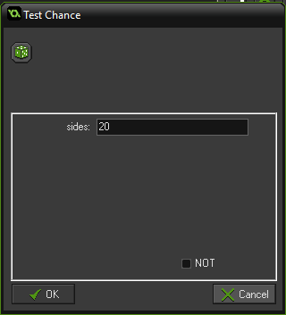
Aliens shooting bombs randomly
When done get the enemy bomb moving down towards the player.

Slide 14
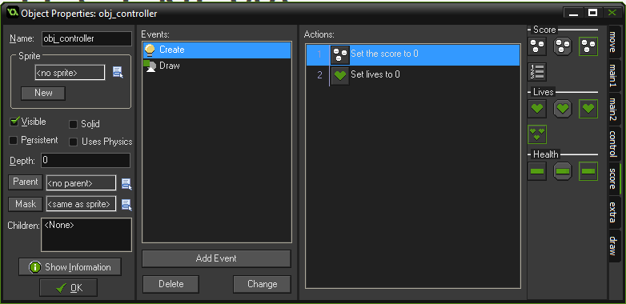
Setting score and lives

Slide 15
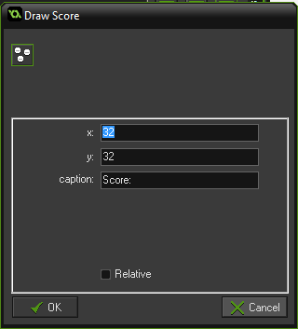
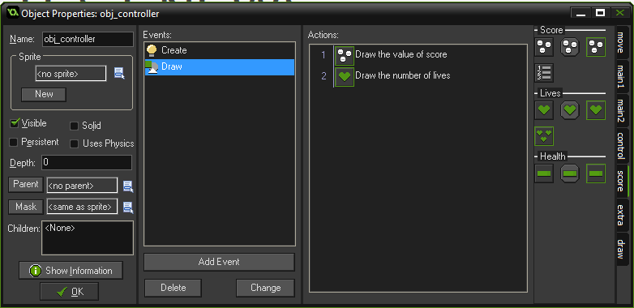
Display score and lives
Once done using the Set Score action add points for each kill. Then using the Set lives action to remove one life when colliding with the bomb

Slide 16
Completing and adding to your game
Place barriers that are destroyed by the player and enemy's fire
Get the bullet to destroy the ghost
More levels that get progressively harder
Have a 3 live system
Add 10 to score with each alien kill
Have a extra UFO enemy that is faster and harder to kill but gives more points

