Slide 1
HCI
P2 Understand hardware technologies for game platforms
Human Computer Interface
P2 -Human-computer interface: interface devices; ergonomic design;
button configurations; user-centred design; portability
P2 - Interface devices: game devices, eg paddle, joystick, keyboard, joypad, mouse, wheel,
pedals, eye toy;ports; wireless; cabled; analogue; digital; controller ports

Slide 2
What is HCI?
Human Computer Interface is how us as humans interact with computers, electronics and in our case games.
Can you think of any devices we use to play games?

Slide 3
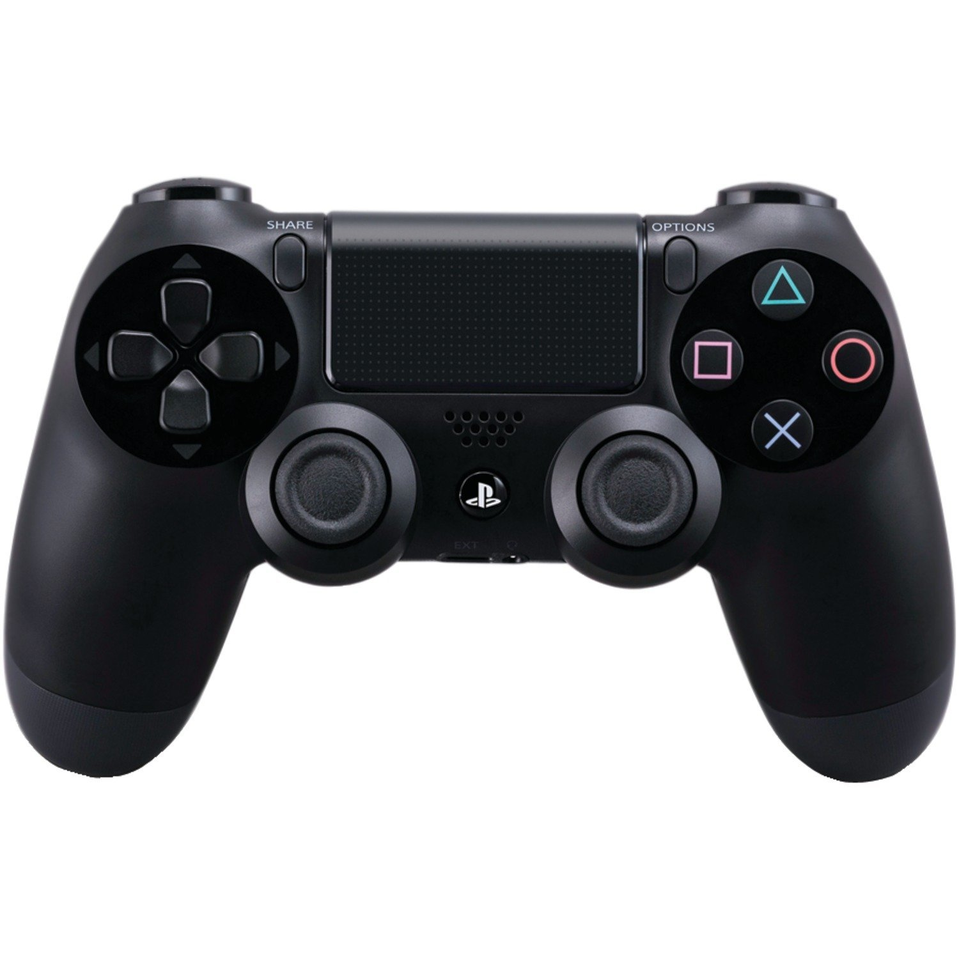
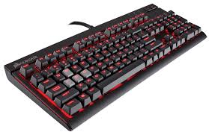
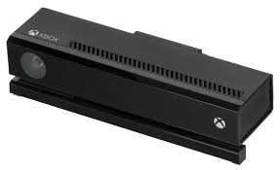
Human Computer Interface devices
Controllers
Joysticks
Keyboards
Mouse
Wheels
Pedals
Motion sensing input device(Kinect, eye toy)
Motion-Controllers(Wii Mote, PlayStation Move)
VR Headsets(Oculus Rift, HTC Vive, PS VR)

Slide 4
How many gaming HCI can you get from the following quiz?
bzfd.it/2dC9CM3

Slide 5
Ergonomic design
The practice of designing products, systems, or processes to take proper account of the interaction between them and the people who use them. In this case gamers.
Controllers and peripherals in gaming are specifically designed to be comfortable and easy to use for long periods at a time.
Think about how the devices curve around your hand.
Controllers such as the PlayStation 4 and Xbox One have been revised over several generations to be as comfortable as possible.

Slide 6
Ergonomic Design
Safety
Comfort
Ease of use
Performance (productivity)
Aesthetics

Slide 7
Button configurations
The layout of buttons on the controller or device
The buttons on modern controller are very deliberately placed
Commonly used buttons need to placed near to free fingers for quick access
All buttons must be accessible without moving the entire hand.
Why are the option buttons placed in the hardest to reach areas of the controller?

Slide 8
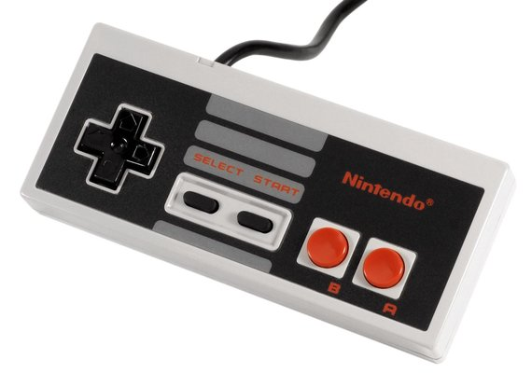
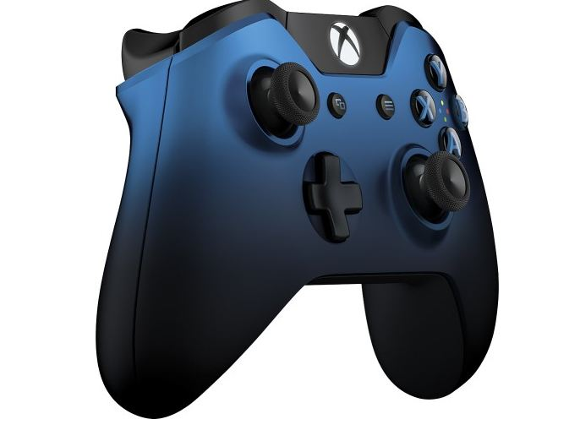
Think About the NES Controller
Now Xbox One
Why do we have more buttons on controllers these days?

Slide 9
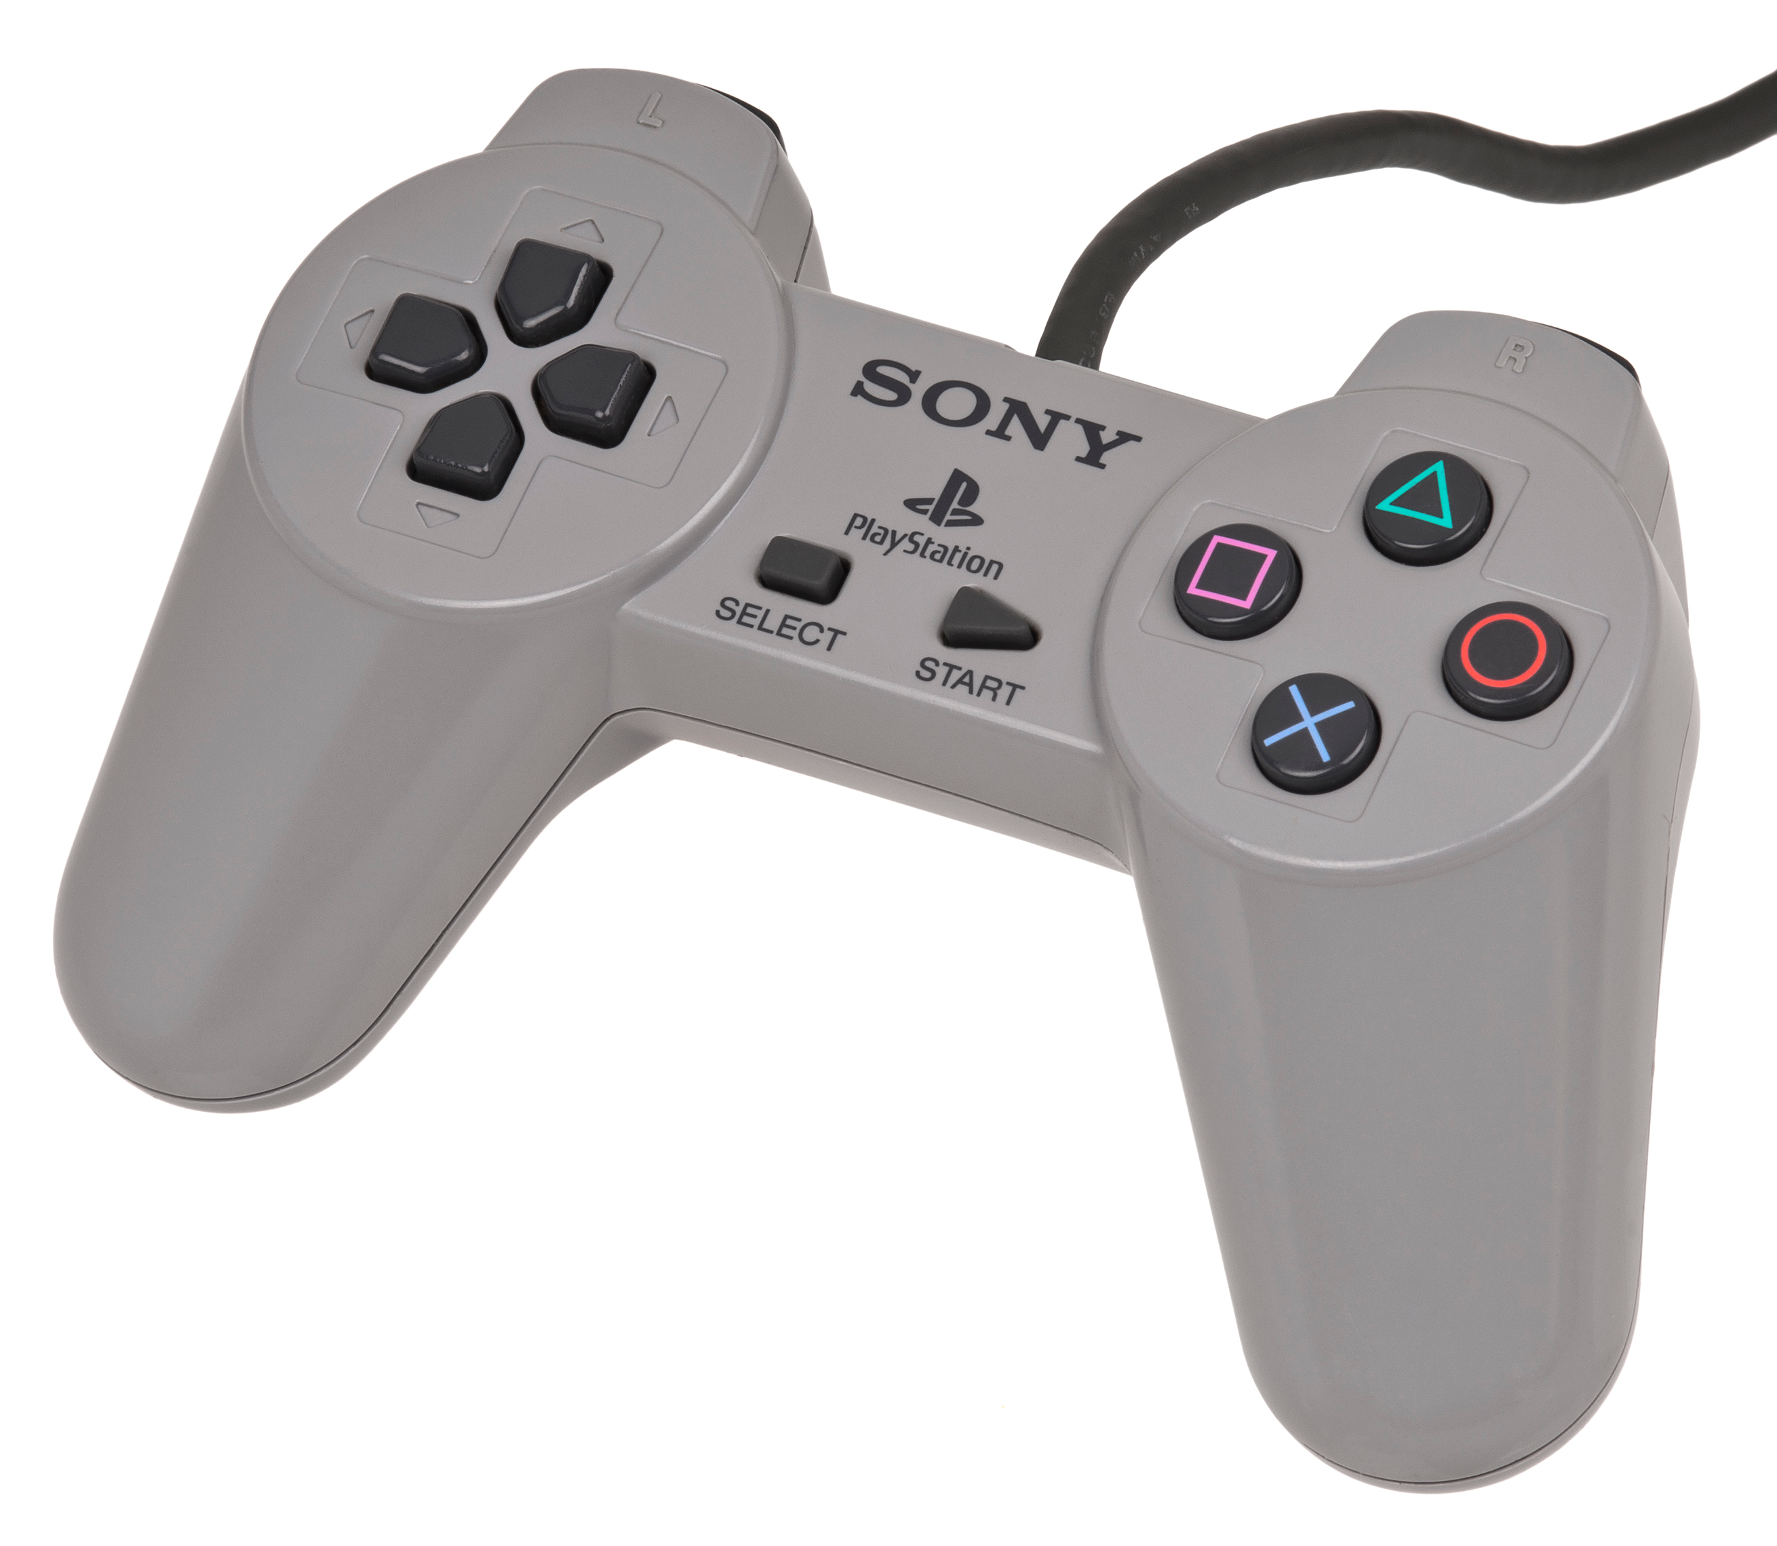
Analogue vs Digital
Analogue
Digital

Slide 11
Task A – Understanding hardware technologies for game platforms
1. Introduce and explain what HCI(Human Computer Interface) in the context of gaming is.
2. List and explain the following interface devices: Controllers, Joysticks, Keyboard, Mouse, Wheel & Pedals, motion sensing input device(Kinect, PlayStation Camera), Motion-Controllers(Wii Mote, PlayStation Move), voice controllers, VR Headsets(Oculus Rift, HTC Vive).
Include examples and references.

Slide 12
User-centred design
All HCI devices go through a User-centred design process.
Design is based upon an explicit understanding of users, tasks, and environments. It is driven and refined by user-centered evaluation and addresses the whole user experience.
There are many variations of the UCD process.

Slide 13
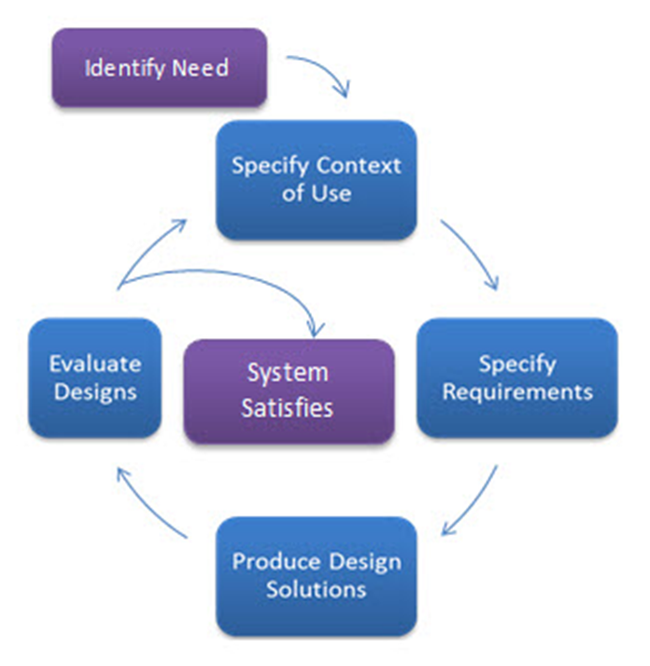
User-centred design
Specify the context of use: Identify the people who will use the product, what they will use it for, and under what conditions they will use it.
Specify requirements: Identify any business requirements or user goals that must be met for the product to be successful.
Create design solutions: This part of the process may be done in stages, building from a rough concept to a complete design.
Evaluate designs: Evaluation - ideally through usability testing with actual users - is as integral as quality testing is to good software development.

Slide 14
Portability
Why do we want gaming HCI to be portable, light and easy to use?
Why do we want wireless over wired devices?
What about battery life?

Slide 15
Think About the NES Controller
Now Xbox One
How has the controller evolved over the years?

Slide 16
Task B – Understanding hardware technologies for game platforms
1. Now take the NES controller and compare it to a current generation controller(Xbox One, PS4, Wii U). Look at the ergonomic design, button configurations, user-centred design and portability of both.
2. Include all the features of modern controllers and what they are used for.
3. If you could add one thing to a modern controller what would it be?

