Slide 1
First Animation Exercise
Bouncing Ball

Slide 2
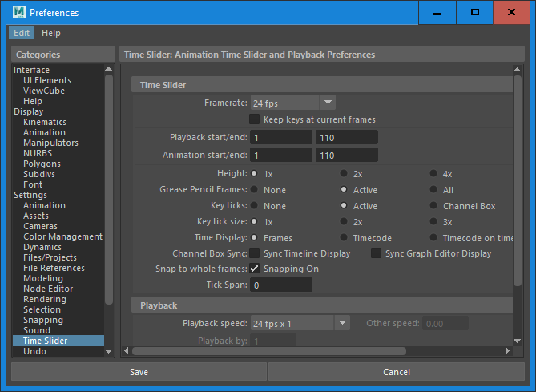
Setup
Set Animation preferences – 24FPS

Slide 3
Setup
Set Time Slider – 110 Frames
Insert Polygon Sphere
Change centre faces to a different colour of Sphere – See opposite
Select Frame 1 Translate Y value = 38. Press the S key to insert a keyframe.

Slide 4
Insert the remaining keyframe locations
Frame 1 Translate Y value = 38
Frame 9 Translate Y value = 0
Frame 17 Translate Y value = 17
Frame 25 Translate Y value = 0
Frame 32 Translate Y value = 25
Frame 39 Translate Y value = 0
Frame 45 Translate Y value = 19
Frame 51 Translate Y value = 0
Frame 56 Translate Y value = 13
Frame 61 Translate Y value = 0
Frame 65 Translate Y value = 9
Frame 69 Translate Y value = 0
Frame 71 Translate Y value = 6
Frame 75 Translate Y value = 0
Frame 77 Translate Y value = 4.5
Frame 79 Translate Y value = 0
Frame 81 Translate Y value = 2.5
Frame 83 Translate Y value = 0
Frame 85 Translate Y value = 1.5
Frame 87 Translate Y value = 0
Frame 88 Translate Y value = 0.5
Frame 89 Translate Y value = 0

Slide 5
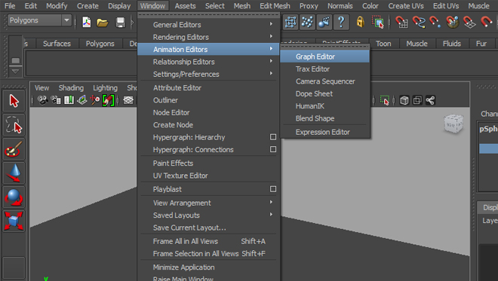
Graph Editor
With the ball selected go to Window>Animation Editors>Graph Editor to open it up.
The first thing you need to do is select the Translate Y curve which is located in the Graph Editor outliner on the left hand side.

Slide 6
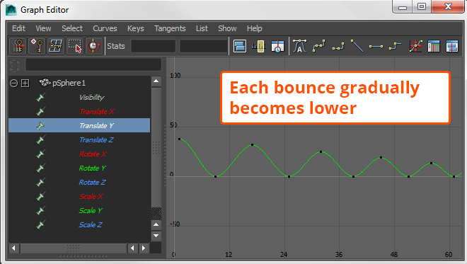
Your curve should resemble what you see in the example image, looking similar to a wave pattern.
For the ball bounce to feel like a real ball bounce we will need to adjust these curves.

Slide 7
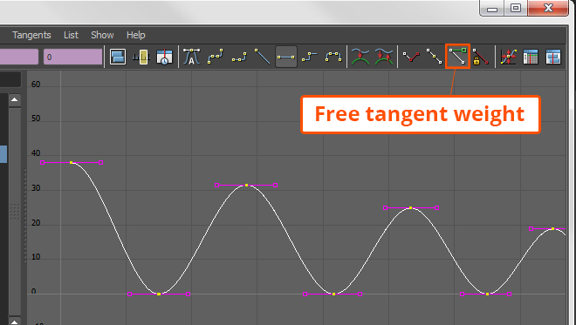
Marquee select the entire curve, and free the tangent weights.
This is located in the toolbar, as shown in this screenshot.

Slide 8
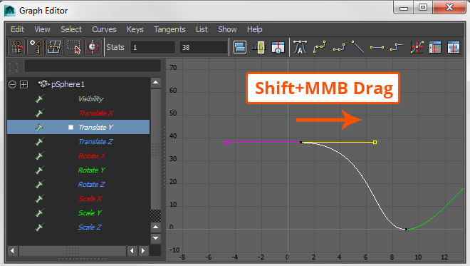
After you've done that, select the first keyframe on the curve
All the keyframes are represented as black dots on the curve.
You will notice a purple line extending out in both directions.
These are called tangent handles, and this is what you need to manipulate to adjust the spacing. Select one half of the tangent handle on the first keyframe and while holding down Shift+MMB drag to the right.
This widens the curve.

Slide 9
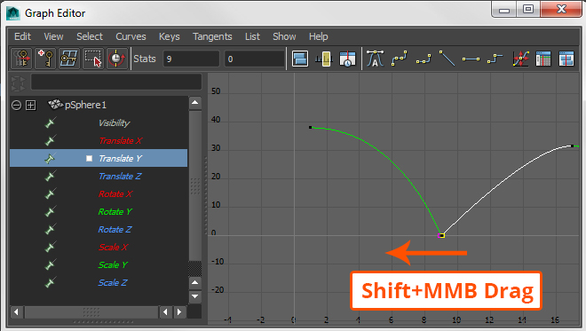
Now go to the next keyframe on frame 9.
This time select the right side of the handle and Shift+LMB drag to the left until the tangent handle is barely visible.

Slide 10
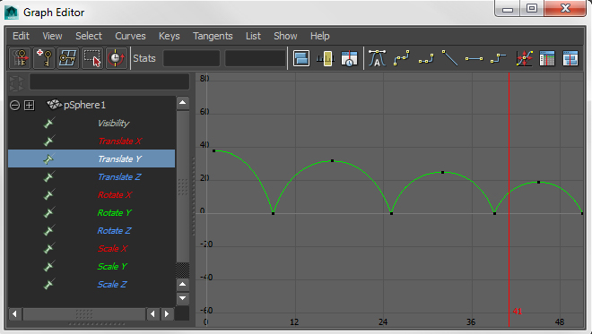
Repeat this procedure for the rest of the keyframes.
The high points of the bounces should have a tangent handle that is very wide, and tangent handles on the keyframes where the ball hits the ground should be brought inward like before.
This creates a nice rounded arc for each bounce. Once you've finished your curve should look the screenshot.

