Slide 1
Week 2
Unit 27 – Network Operating System

Slide 2
Disaster recovery
Theory leading to Assignment 1

Slide 3
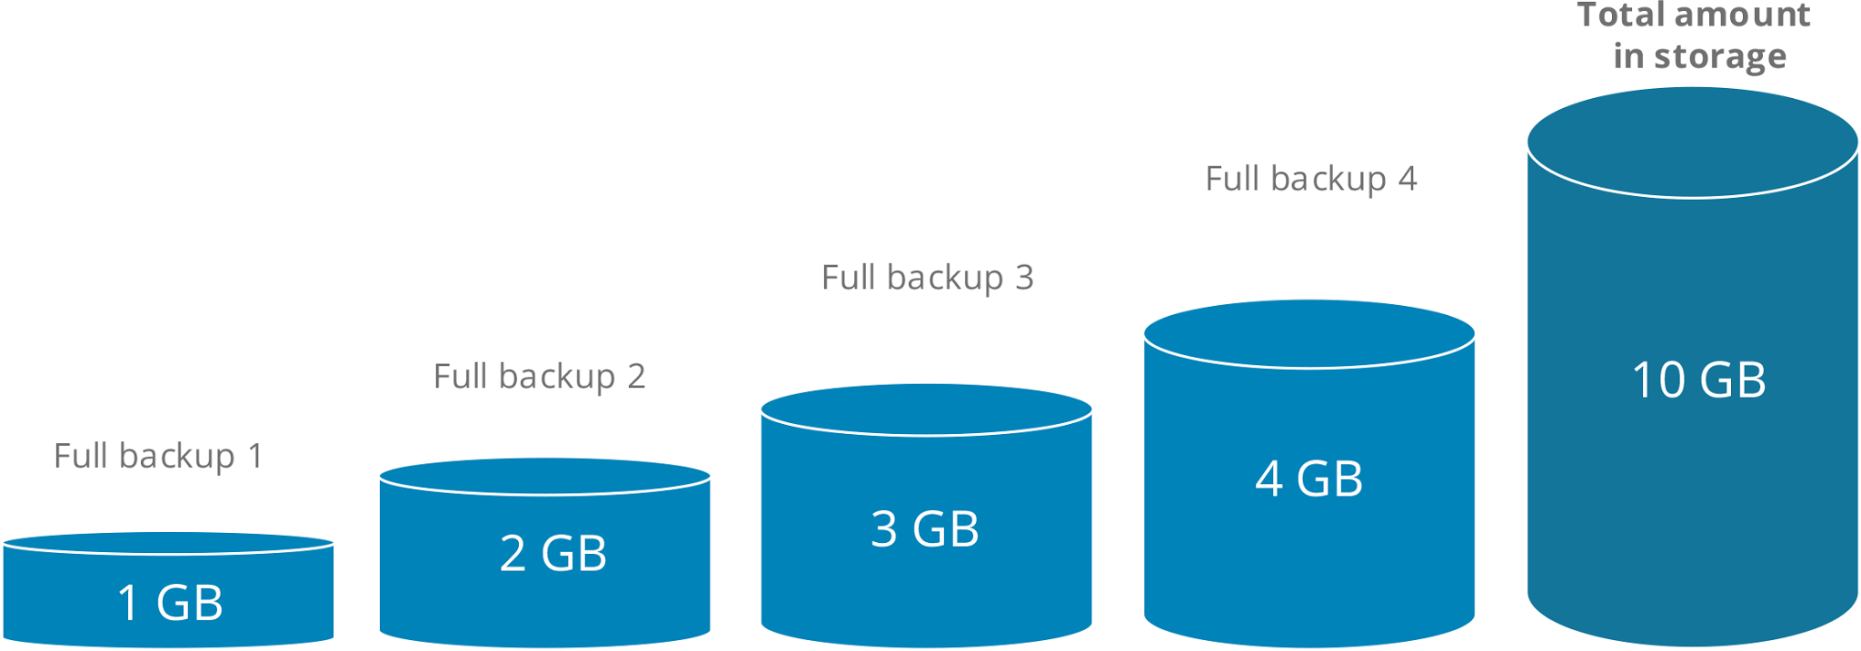
Disaster recovery: Backup Mythology Full Backups
Stores a copy of all files and typically occurs automatically according to a pre-set schedule.
Files are usually compressed to save space, however, even when compressed full backups may consume a lot of storage.
Notes:
Image reference: https://www.cloudberrylab.com/incremental-backup-vs-differential-backup.aspx

Slide 4
Disaster recovery: Backup Mythology Full Backups
Disadvantages include causing heavy access to the backup disk, which shorten disk life and consume network bandwidth.
More robust than many businesses require. Only a small percentage of files change from one backup to another.
Will yield multiple identical copies of files and consume valuable storage space on the backup medium.
An advantage is the ease of restoration. Restoring a file requires only the file name, location, and date from which to restore the data.

Slide 5
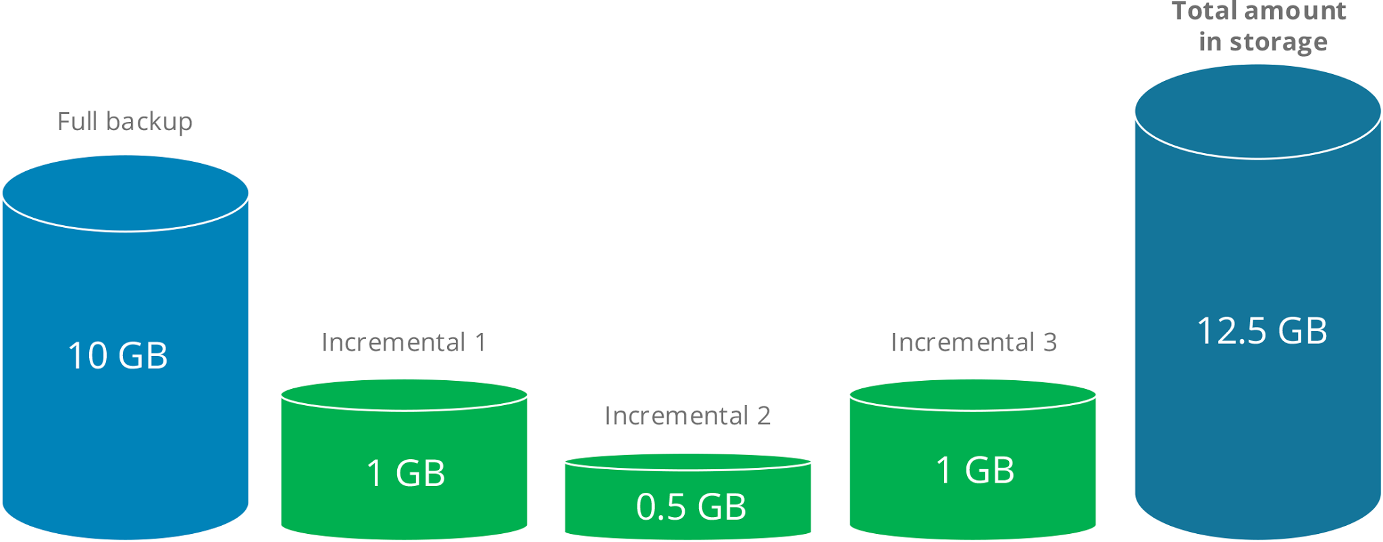
Disaster recovery: Backup Mythology Incremental Backups
Backup only the files that have been created or changed since the last backup.
Usually backup strategies include a combination of full backups and incremental backups.
Running a full backup once per week—on weekends when network and computing resource demands are lower—and scheduling incremental backups on weekdays.
Backing up files with this combination enables a restoration that does not require looking through or merging more than a week’s worth of iterations.
Notes:
Image reference: https://www.cloudberrylab.com/incremental-backup-vs-differential-backup.aspx

Slide 6
Disaster recovery: Backup Mythology Incremental Backups
An advantage is that the volume of data backed up at each iteration is much smaller, which in turn saves space on the backup medium and uses less network bandwidth.
Disadvantages include backups increasing computing overhead, each source file must be compared with the last full backup as well as the incremental iterations to determine whether data is new or changed.
More complex to locate a specific file to restore as it may require searching several iterations. To completely restore all files requires merging all iterations while taking care to keep only the most recent version of each file.

Slide 7
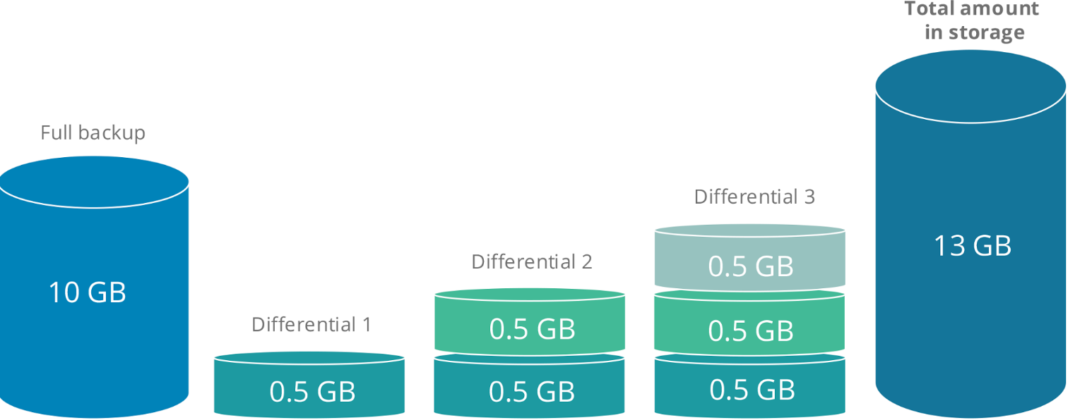
Disaster recovery: Backup Mythology Differential Backups
Differential backups are similar to incremental backups, except that each backup operation stores the new and updated files since the last full backup.
For example, if a full backup was performed on Sunday and a file changed on Monday, that file will be part of every differential backup until the next full backup is run.
Notes:
Image reference: https://www.cloudberrylab.com/incremental-backup-vs-differential-backup.aspx

Slide 8
Disaster recovery: Backup Mythology Differential Backups
Using differential backups simplifies recovery because only the last full backup and the last differential backup is needed to create a complete restoration.
As with incremental backups, differential backups need to compare current and already-backed-up files to identify any changes.
However, differential backups require more space and network bandwidth compared with incremental backups.

Slide 9
Disaster recovery:
Data Recovery: If data has been backed up it can be recovered by simply installing the backup. If not, through the use of specialised software deleted or corrupted data can be recovered.
Mirrored Systems: A second backup server has an exact copy of another server. If one goes down the other takes over meaning no downtime to the network.
Virtualisation: One physical server split into multiple isolated virtual environments. Reduces physical space and cost.
UPS (Uninterruptible Power Supply)/Backup Power supply: Battery devices that connect to a physical server to give it power when the primary source of power fails.

Slide 10
Disaster recovery:
Off site management: Off site backup allows copied server data stored physically away from the main site. Should the server and data be damaged at one site through fire or flooding for example there is a backup still available.
High availability: How operational the server is. By having regular backups, UPS’s set up and offsite management available your server should be 99% available and therefore considered to have high availability.
Fault tolerance: By having two separate machines that are mirrored. In the event that the main system has a hardware failure, the secondary system takes over and there is zero downtime.

Slide 11
Unit 27 – Network Operating Systems Assignment 1 - Task 1.2
Add a section to your report that discusses the benefits of disaster recovery.
Cover the following points; backup methodology, data recovery, mirrored systems, virtualisation, UPS (Uninterruptible Power Supply), backup-power supply, off site management, high availability and fault tolerance.
Use Harvard referencing and examples whenever possible.

Slide 12
Practical: Setup Windows Server Backup
Launch the Server Manager.
In the right-hand menu, click on Manage > Add roles and functionalities.
Select “Install based on a role of functionality” and click on “Next”.
Select the server where you want to install the backup functionality.
Click on “Next” since you do not want to install a specific control.
Select “Windows Server Backup” from the list and click on “Next". If “Windows Server Backup” is not displayed on the list, use the vertical scroll bar located at the right of the functionalities list.
Place a checkmark in “Automatically restart the destination server, if necessary” and click on “Yes” and “Install” to launch the install of Windows Server Backup.
The install process will run in the background, you can close the window by clicking on “Close”.
You can click on the Notifications Center icon (in right upper corner of the Server Manager) to see the progress of the installation.

Slide 13
Practical: Use Windows Server Backup
Once the install has successfully completed, you can launch the backup management utility from the Tool menu of the Server Manager.
Selecting configure performance and Custom allows you to set up incremental backups.
The Windows Server Backup utility lets you create and manage backups, restore files and see the system’s status.
It also lets you plan complete or personalized (specific disks, for example) server backups.

Slide 14
Practical: Promote to Domain Controller
A domain controller (DC) is a server computer that responds to security authentication requests (logging in, checking permissions, etc.) within a Windows domain.
Manage > Add roles and features > Install Active Directory domain services
Don’t enable Azure – Cloud based active directory
Promote server to domain controller
Add new forest – Default – 2016 functional level
Name + password
Keep clicking next and install

Slide 15
Practical: Active Directory
Active Directory is a centralized and standardized system that automates network management of user data, security, and distributed resources, and enables interoperation with other directories. Active Directory is designed especially for distributed networking environments.
Tools > Active directory User and computers
New organisational unit (Set to protect container against accidental deletion)
Create a company organisational Unit (e.g ABC Computing)
Within that create a Users Folder
Create one user – Set to change password Next time
Create a new group – call it SG-SharedData-RW
(Scope: Global, Type Security).
Add your user to the security group
Active Directory Admin Centre > Enable Recycle bin

Slide 16
NOS Security
Theory leading to Assignment 1

Slide 17
NOS security:
Management of updates/patches: Keeping your server software and client installed software uptodate will eliminate potential holes in security.
Anti-virus protection: Essential on a server. Microsoft Endpoint is an example that protects servers and devices on the network. Alerts can be set to notify the Admin but usual kills viruses automatically.
Physical access policies: Who can access your server? Key coded or locked servers rooms are essential. Access should be restricted only to admin.
Service access policies: Examples include e-mail, file, web and printing. Who needs access to what? Policy's should ensure that only users who need services have access to them.

Slide 18
NOS security cont.
User access policies: Who has access to the network? Users should have username and passwords setup and only access to data essential to their role.
Policy management: Through group policy management network admins can restrict user access and control what they can add and change.
User and group audits: Maintaining a log and monitoring users network usage to maintain security. Can be set in Group policy. Firewalls and filters could restrict access to undesirable websites.
Continual vetting of access: Consistent consideration of who should have access to what. Based on job role and audits.

Slide 19
NOS security cont.
Authentication policies and practice: Methods put in place to safeguard access to network services including internet. Password or fingerprint scanners could be considers as ways to authenticate access.
Password policy: Passwords could be set to change every 90 days or have a minimum of 8 characters with numbers, uppercase and lowercase lettering.

Slide 20
Unit 27 – Network Operating Systems Assignment 1 - Task 1.2
Now as part of 1.2 discuss the benefits of NOS security.
Cover the following points: management of updates/patches, anti-virus protection, physical access policies, service access policies, user access policies, policy management, user audits, group audits, continual vetting of access, authentication policies and practice, password policy
Use Harvard referencing and examples whenever possible.

Slide 21
Practical: Dynamic Host Configuration Protocol (DHCP)
Protocol used on TCP/IP networks whereby a DHCP server dynamically assigns an IP address and other network configuration parameters to each device on a network so they can communicate with other IP networks.
You will setup DHCP and configure a scope for your network.
Manage > Add roles & features > DHCP Server > install
Select complete DHCP configuration
Check credentials > Authorize > Close window
Tools > DHCP > Right click DHCP > New Scope
Give it a name
Configure range – See next slide

Slide 22
Practical: Dynamic Host Configuration Protocol (DHCP)
Example scope shows 200 IP addresses in it’s scope
Page after allows you to set up IP addresses that are excluded from this range or delay speed.
You can also change the lease. How long the IP addresses available to the device.

Slide 23
Practical: Dynamic Host Configuration Protocol (DHCP)
It will ask you to configure more options. Select yes.
Input router IP: 192.168.25.???
Input DNS server IP: Your servers IP(May be auto entered)
Next page asks about WINS. Ignore and click next, old version of DHCP configuration.
Click next and activate. Finish. Scope is configured!
Right click the scope you want to make changes later.
Test on client by making sure client is logged into the network and IP addresses and DNS server addresses are obtained automatically.
Check IP leases on server. It should show the client.

