Slide 1
Intro to GML

Slide 2
What is GML?
A proprietary interpreted programming language called the GameMaker Language (abbreviated to GML).
Gives you much more flexibility and control than the standard actions that are available through the Drag'n'Drop interface. Can be used in:
  Scripts: A script is a (usually) short snippet of code in GML that you write to create your own functions.
  Events: You can use code within object events to control the behaviour and interactions of instances of those objects. You can even mix Drag'n'Drop with code!
  Room Creation Code: Each room can have a special "create event" specific for that room. Here you can add the code you need and it will be run when every time the room is entered.
  Instance Creation Code: As well as the code you insert into the events of an object, you can also add code to individual instances when you place them in the room.
Notes:
Can be turned to compiled code when ran through one of the export modules.

Slide 3
Gamemaker Langugage
Using Gamemaker Language we will create a simple click-the-object game. There will be an object that appears at random positions and the aim of the game is to click it before the timer runs out. Each time you successfully click the object the timer will get faster. If you don’t click the object before the time runs out, the game ends.

Slide 4
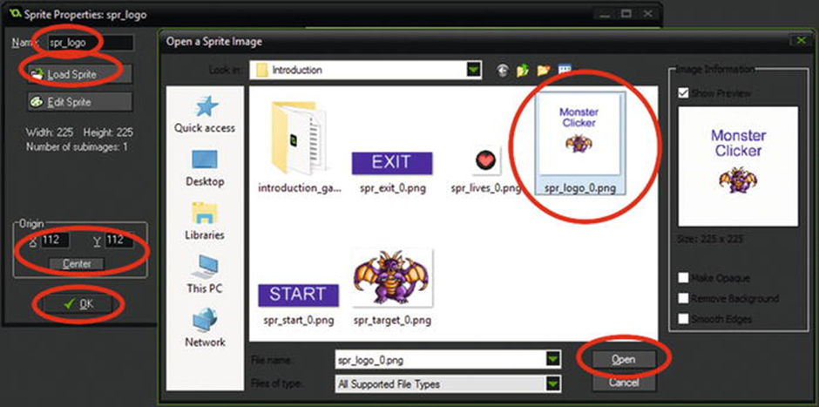
Download the sprites as instructed by your tutor.
Load in the sprites for this game. There are five of them, spr_logo , spr_start_game , spr_target , spr_exit , and spr_lives .
Set the origin of all sprites to center. The origin is point in the sprite where it will be positioned in the room.

Slide 5
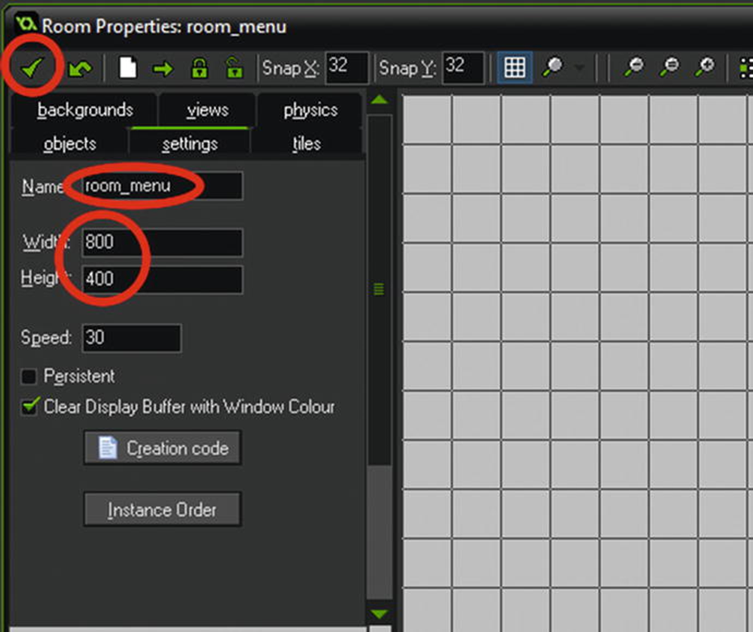
Creating rooms
Create two rooms; name them room_menu and room_game. Set the room size for each as 800 by 400.

Slide 6

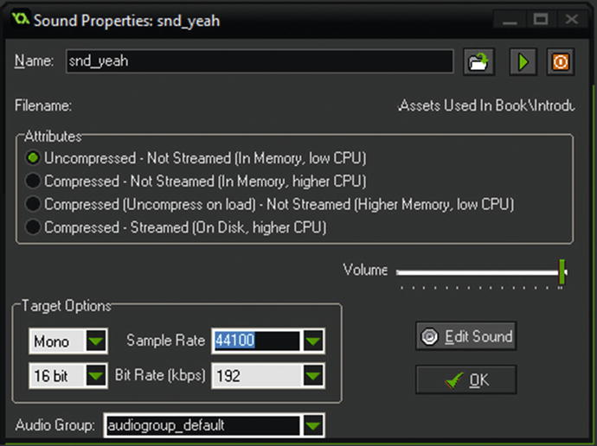
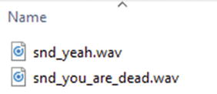
Sounds
Create and load two sounds: snd_yeah and snd_you_are_dead .

Slide 7

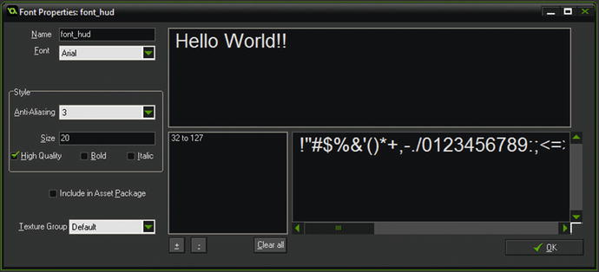
Fonts
If you want to display text or variables on screen in your game, you’re going to need to define and name some fonts.
Set the font name as font_hud and the size as 20 Arial as shown in Figure

Slide 8

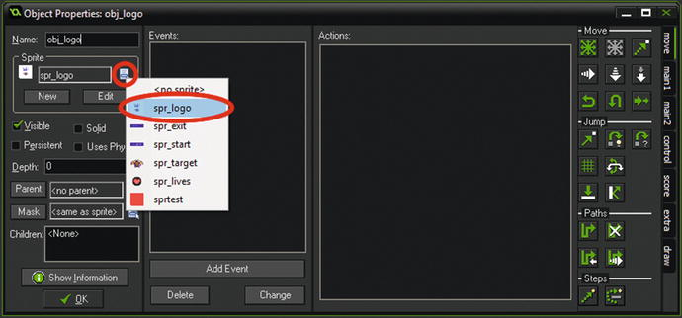
Objects
Next we’ll create the objects. There are five of them: obj_logo , obj_start_game , obj_target , obj_exit , and obj_hud .
Assign the relevant sprites to the objects. NO SPRITE FOR OBJ_HUD

Slide 9
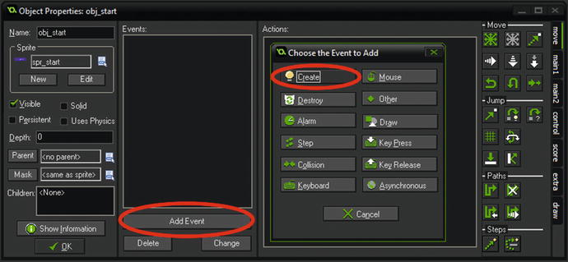
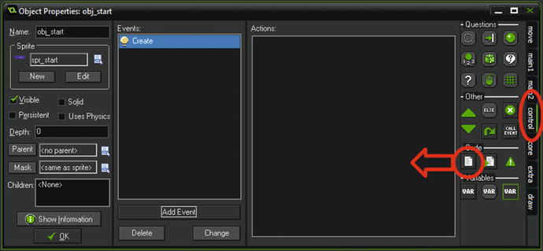
Events
Within obj_start_game add the create event.
Click on the control tab, and click and drag Execute Code to the actions window

Slide 10
Add code
In the open window, enter the following code:
//see if ini file exists and load saved score
Ini_open("savedata.ini"); //open file savedata.ini
global.highscore = ini-read_real("score", "highscore", 0); //set global.highscore to value or set as 0 if no value present
Ini_close(); //close ini file - always do this after loading or saving data
//set starting values for game:
score=0;
lives=5;
This code will load any high score from a previous play of the game to the variable global.highscore , set current score to 0 , and lives to 5 .

Slide 11
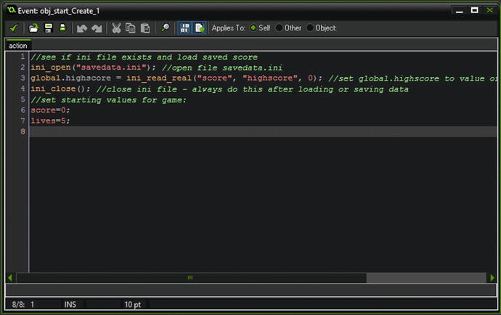
Your code should look like this

Slide 12
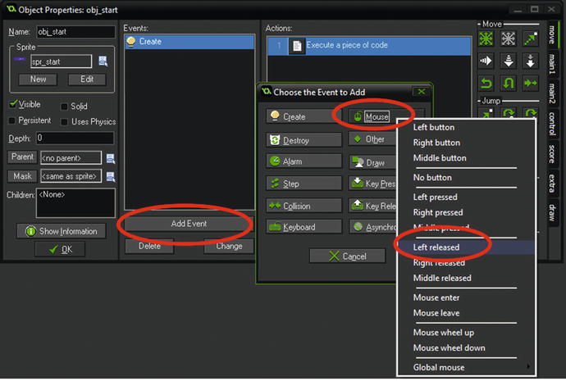
Mouse Left Button Released Event
Now create the new the event shown:

Slide 13
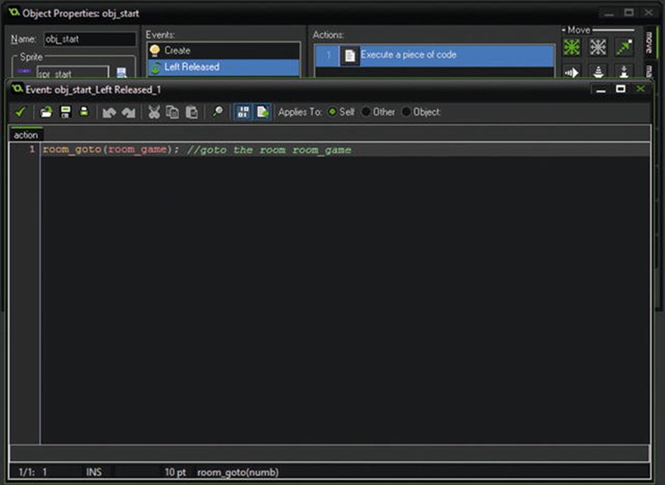
Mouse Left Button Released Event - Code
Again drag over the Execute Code action and add the following code
Notes:
room_goto(room_game); //goto the room room_game

Slide 14
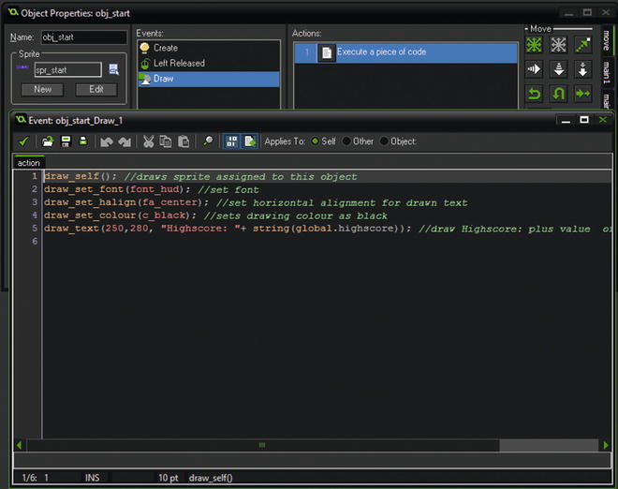
Add a draw event
Next add a Draw Event by clicking Add Event followed by Draw Event , then drag across the Execute Code . Add the following GML to this:
Notes:
draw_self(); //draws sprite assigned to this object
draw_set_font(font_hud); //set font
draw_set_halign(fa_center); //set horizontal alignment for drawn text
draw_set_colour(c_black); //sets drawing colour as black
draw_text(250,280, "Highscore: "+ string(global.highscore)); //draw Highscore: plus value of global.highscore

Slide 15
Draw event explained
A Draw Event is where you place your code, or D&D, to place text and images on the screen. Drawing functions, such as draw_text and draw_self , must be placed in Draw Event.
Explanation of this code:
draw_text(250,280, "Highscore: "+ string(global.highscore)); //draw Highscore: plus value of global.highscore
This draws the text at position 250 across the screen and 280 down, in pixels.
global.highscore has a numerical value. Because we are drawing it with a string, " Highscore: ", we need to convert it also to a string. The code string(global.highscore) does this conversion.

Slide 16
Obj_exit
For this object create a Left Mouse Button Released Event and add this code:
game_end(); //closes game and returns to windows

Slide 17
obj_target
Next we’ll use a Create Event to set up some initial variables. A Create Event is only run once when the object is created, or when a room starts if the object is already placed in it.
We’ll use this event to create at a random position across the screen, X, and down the screen Y between 100 and 700.
We’ll then start an Alarm with a value of 100 minus the score. This makes the alarm quicker as the score increases, making it get progressively harder to click in time.

Slide 18
obj_target continued
In a Create Event put this code, which will choose a whole integer between 100 and 700, sets timer to 100 less the score, with a minimum value of 5, and then sets an alarm with the timer:
x=irandom_range(100,700); //sets x position at random between 100 & 700
y=irandom_range(100,300); //sets y position at random between 100 & 300
timer=100-score; //set timer as 100 less score - so it gets faster
if timer<=5 timer=5; //check if less than 5, set as 5 if it is
alarm[0]=timer;
Notes:
x=irandom_range(100,700); //sets x position at random between 100 & 700
y=irandom_range(100,300); //sets y position at random between 100 & 300
timer=100-score; //set timer as 100 less score - so it gets faster
if timer<=5 timer=5; //check if less than 5, set as 5 if it is
alarm[0]=timer;

Slide 19
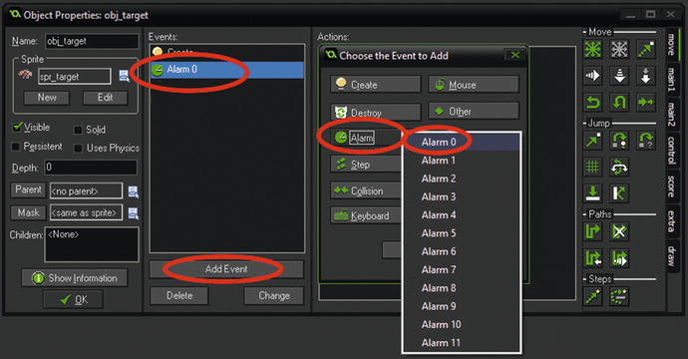
obj_target continued
Next create an Alarm Event0 as shown.
This will activate if the player hasn’t clicked the object in time. The GML will play a sound first, reduce the player’s lives by 1, and create a new object, then destroy itself.

Slide 20
obj_target continued
Drag across Execute Code and add the following code:
audio_play_sound(snd_you_are_dead,1,false);//plays a sound
lives-=1; //reduce lives
instance_create(50,50,obj_target); // create a target
instance_destroy(); //destroy self

Slide 21
obj_target continued
Create a Left Mouse Button Released Event into the same object, obj_target and put the following code in it:
score+=1; //add 1 to score
audio_play_sound(snd_yeah,1,false); //play sound yeah
instance_create(50,50,obj_target); //create new skull
instance_destroy(); //removes self from screen

Slide 22
obj_target continued
In a Draw Event of obj_target put:
draw_self(); // draws assigned sprite
draw_set_colour(c_red); //sets drawing colour
draw_rectangle(x-(alarm[0]/2), y-30, x+(alarm[0]/2), y-25,0); //draws a rectangle that reduces size based on alarm[0] value
The above code will draw the sprite for the object, set the drawing colour to red, and then draw a rectangle based on the current value of the alarm – this will serve as visual so the player knows how long they have to click the object.

Slide 23
obj_hud
There is no sprite for this object.
This object will be used as a control object that will be used to draw a HUD of the player’s lives and score . It will also monitor how many lives the player has, and if the player has lost all of their lives it will update the high score if the player has a new high score and then restart the game. You do not need to create this file; it will be created automatically upon saving if it doesn’t already exist.

Slide 24
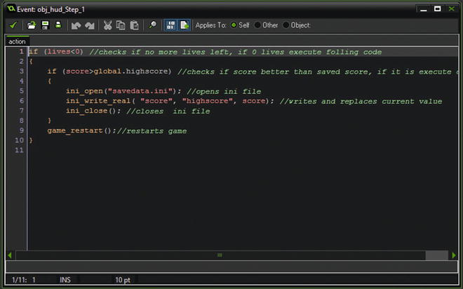
obj_hud – Creating a ini file
Click Add Event and then Step Event . Add the following code to the Step Event :
Notes:
if (lives<0)
{
if (score>global.highscore)
{
ini-open("savedata.ini");
ini-write_real( "score", "highscore", score);
ini-close(); //closes ini file
}
game_restart(); //restarts game
}

Slide 25
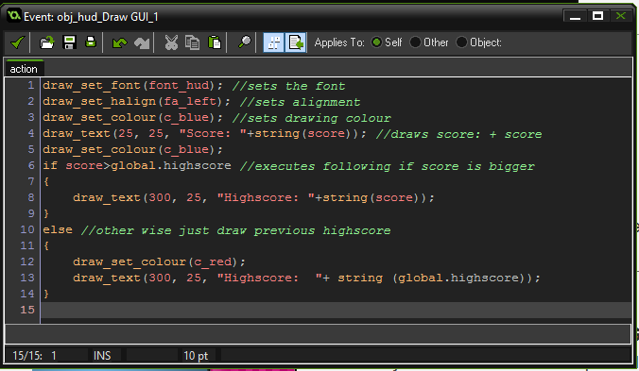
obj_hud – Score, font, alignment, and drawing colour
Create a Draw GUI Event, under the draw tab. This code sets up the font, alignment, and drawing colour. Then it draws the score and as a high score if bigger than previous global.highscore .
Notes:
draw_set_font(font_hud); //sets the font
draw_set_halign(fa_left); //sets alignment
draw_set_colour(c_blue); //sets drawing colour
draw_text(25, 25, "Score: "+string(score)); //draws score: + score
draw_set_colour(c_blue);
if score>global.highscore //executes following if score is bigger
{
draw_text(300, 25, "Highscore: "+string(score));
}
else //other wise just draw previous highscore
{
draw_set_colour(c_red);
draw_text(300, 25, "Highscore: "+ string (global.highscore));
}

Slide 26
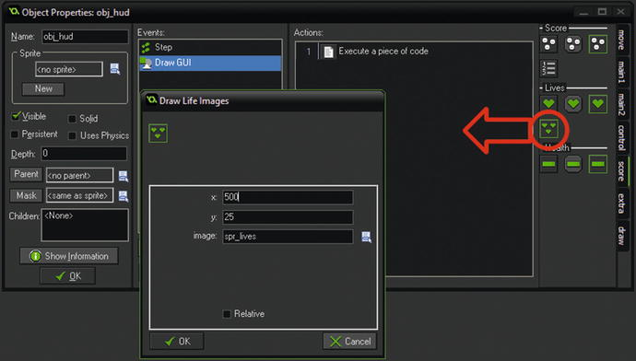
obj_hud – drawing lives
Next is to draw the lives as images. There is a Drag & Drop action for this in the Score section. Drag this across and set to draw at 500,25 using the sprite spr_lives as shown

Slide 27
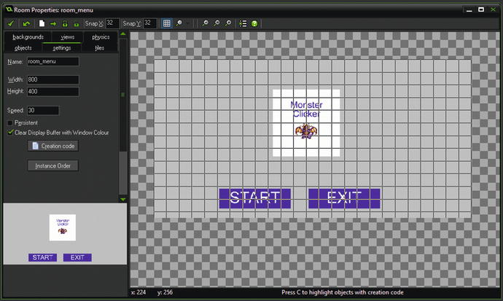
room_menu
Open room room_menu for editing by clicking on it in the resource tree.
Use the object tab to select objects and then place one each of obj_logo , obj_start and obj_exit . Select the object then click in the room to place it.

Slide 28
room_game
Next open room_game .
Place one instance of obj_target and one of obj_hud in the room. It doesn’t matter where you place them.
Save and test the game

Slide 29
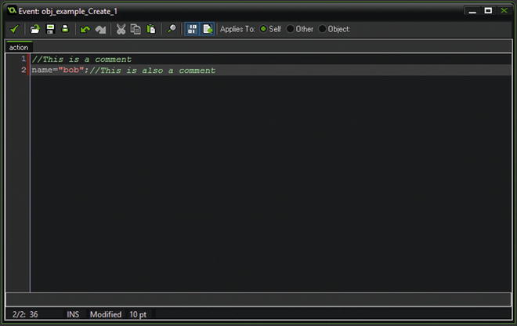
Comments explained
The first type is using the double // . Anything written after the // on a single line is commented out and will not be processed.

Slide 30
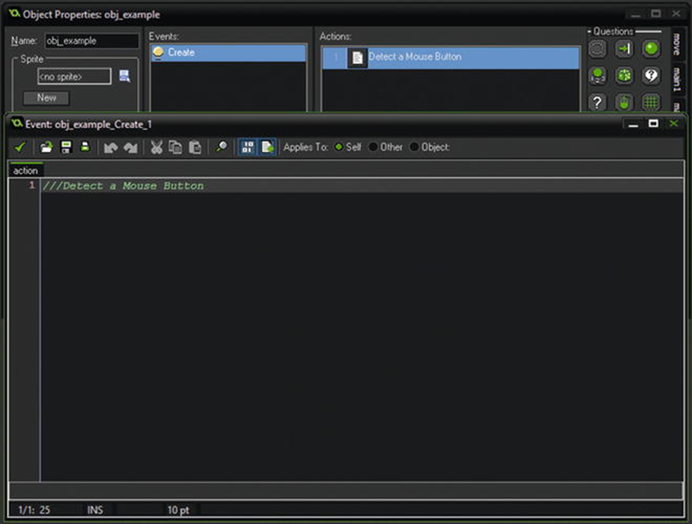
Comments explained
The next type uses the triple /// . When placed at the top of code block it changes the default Execute a piece of code to the comment.

Slide 31
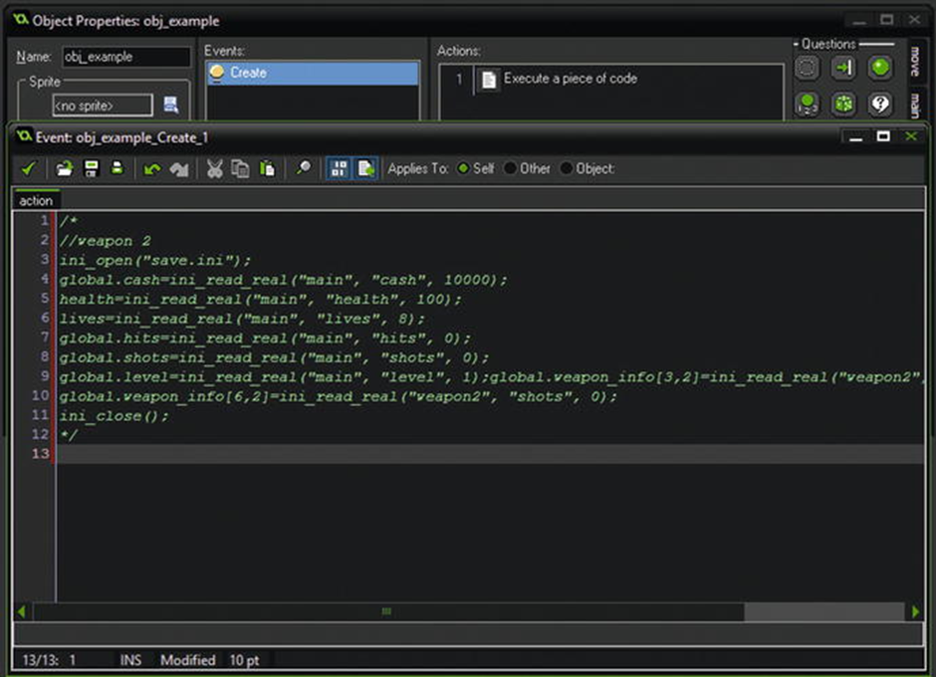
Comments explained
The third type allows you to comment out multiple lines. Any lines commented out will not be executed when the game is run. You start this section with /* and end with */ .

