Slide 1
3D Modelling
Week 2 Terminology Recap

Slide 3
Topology To·pol·o·gy : [tuh-pol-uh-jee] : noun
Whatever type of geometry you use it will either be created by NURBs, or points, edges, and faces.
The way these components are connected together and the flow around the 3D object is the topology.
You can think of topology as the type of polygon faces, the type of vertices and the flow of the edges.

Slide 4
Triangles, quads and ngons

Slide 5
Triangle
A triangle is the simplest polygon that is made up of three sides or edges connected by three vertices, making a three sided face.
When modelling, triangles are typically a polygon type often avoided.
When creating complex meshes, triangles tend to pose a problem when subdividing geometry to increase resolution, and when a mesh will be deformed or animated.

Slide 6
Quad
A quad is a polygon made up of four sides or edges that are connected by four vertices, making a four sided face.
Quads are the polygon type that you’ll want to strive for when creating 3D models.
Quads will ensure your mesh has clean topology, and that your model will deform properly when animated.

Slide 7
N-gon
An n-gon is a polygon that is made up of five or more sides or edges connected by five or more vertices.
It’s important to keep in mind an n-gon is typically related to a five sided polygon, but it’s not limited to just five sides.
An n-gon should always be avoided, they often pose problems at render time, when texturing, and especially when deforming for animation.

Slide 8
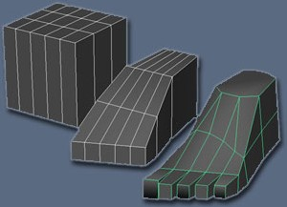
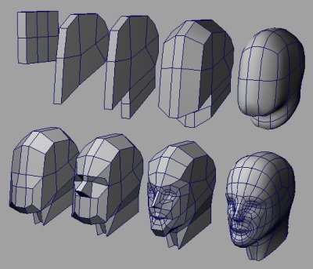
Box Modelling
A technique where a primitive shape (such as a box, cylinder, sphere, etc.) is used to make the basic shape of the final model. This basic shape is then used to sculpt out the final model.

Slide 9
3D Modelling Tasks
Upload your Barrel from last week to Sketchfab. Place a link to this on my website.
Create a low poly chair following the video tutorial (Includes use of box modelling, offset extrusion, merging, symmetry, bevel and soft select)
Using techniques shown in the video create your own Chair and then Table, get a sketchfab link and place this on my website.
Follow the Wine Glass Surfaces Tutorial Video to use NURBS for the first time. Get a sketchfab link and place this on my website.
Tutorials at: jamestedder.net

Slide 10
Task 2

