Slide 1
Conditionals

Slide 2
Conditions – Decision making
Decision Making in programming is similar to decision making in real life.
In programming also we face some situations where we want a certain block of code to be executed when some condition is fulfilled.
A programming language uses control statements to control the flow of execution of program based on certain conditions.
These are used to cause the flow of execution to advance and branch based on changes to the state of a program.

Slide 3
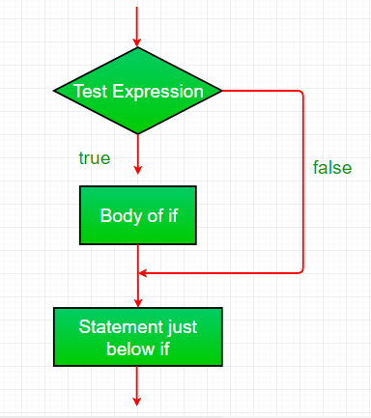
If
Syntax:
if(condition)
{
// Statements to execute if
// condition is true
}

Slide 4
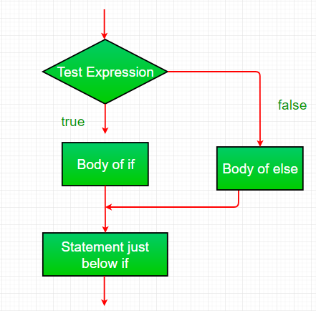
If-Else
Syntax:
if (condition)
{
// Executes this block if
// condition is true
}
else
{
// Executes this block if
// condition is false
}

Slide 5
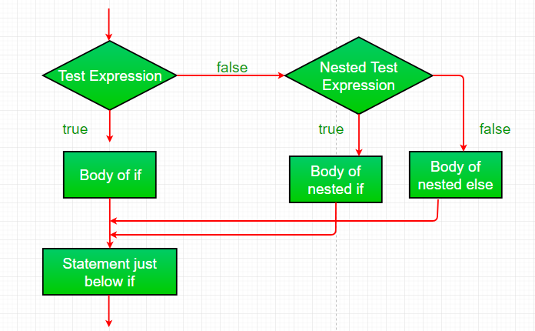
Nested If
Syntax:
if (condition1)
{
// Executes when condition1 is true
if (condition2)
{
// Executes when condition2 is true
}
}

Slide 6
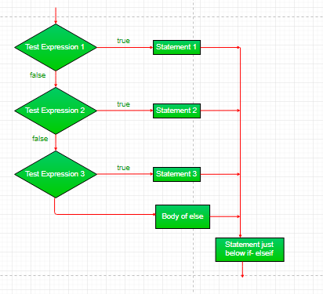
if-else-if ladder
Syntax:
if (condition)
statement;
else if (condition)
statement;
.
.
else
statement;
Notes:
if-else-if ladder: Here, a user can decide among multiple options.The if statements are executed from the top down. As soon as one of the conditions controlling the if is true, the statement associated with that if is executed, and the rest of the ladder is bypassed. If none of the conditions is true, then the final else statement will be executed.

Slide 7
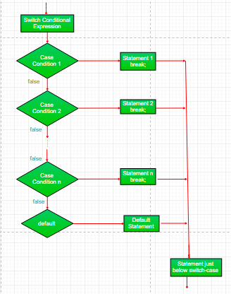
switch-case
switch (expression)
{
case value1:
statement1;
break;
case value2:
statement2;
break;
.
.
case valueN:
statementN;
break;
default:
statementDefault;
}
Notes:
The switch statement is a multiway branch statement. It provides an easy way to dispatch execution to different parts of code based on the value of the expression.
Expression can be of type byte, short, int char or an enumeration. Beginning with JDK7, expressioncan also be of type String.
Dulplicate case values are not allowed.
The default statement is optional.
The break statement is used inside the switch to terminate a statement sequence.
The break statement is optional. If omitted, execution will continue on into the next case.

Slide 8
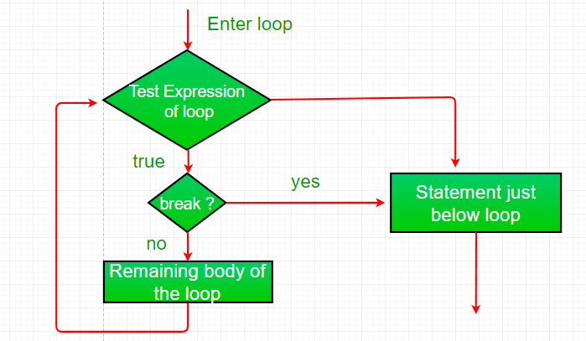
Break statement

Slide 9
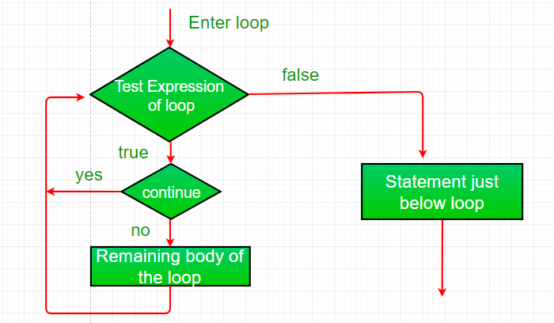
Continue Statement

