Slide 1
Unit 41 – Programing in Java
Week 2 – Syntax,standards & Characteristics

Slide 2
Lesson Aims
Look at the command line and arguments
Discuss characteristics of Java
Understand and use arrays in our code
Launch Assignment 1

Slide 3
Command line and arguments

Slide 4
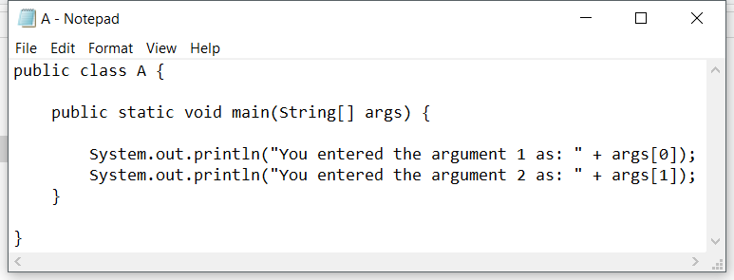
Create the following program in netbeans

Slide 5
Setting up the command line for Java
Find the “advanced system settings” in Control Panel\System and Security\System.
Go into Environment Variables>Edit Path>Select new>Enter “C:\Program Files\Java\jdk1.8.0_111\bin”. Change jdk version or installation folder if not default.

Slide 6
Running your program in command line
Note the opposite image which shows me navigating to the correct folder. Compiling using “javac” and then running the created class file using “java”.
Note “HelloWorld” runs without arguments while “A” has arguments entered into the command line. See the code opposite showing how to accept arguments.

Slide 7
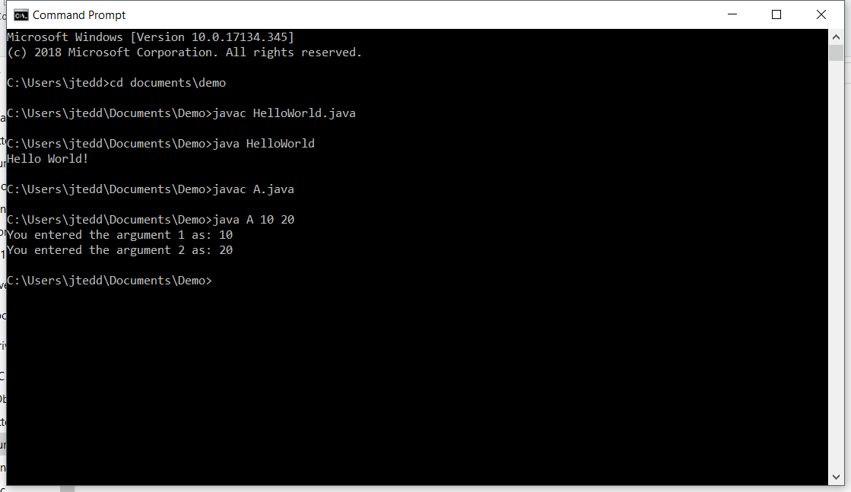

Slide 8
Arguments
The main method contains a String Array called “args”. We can give this array values through the command line.

Slide 9
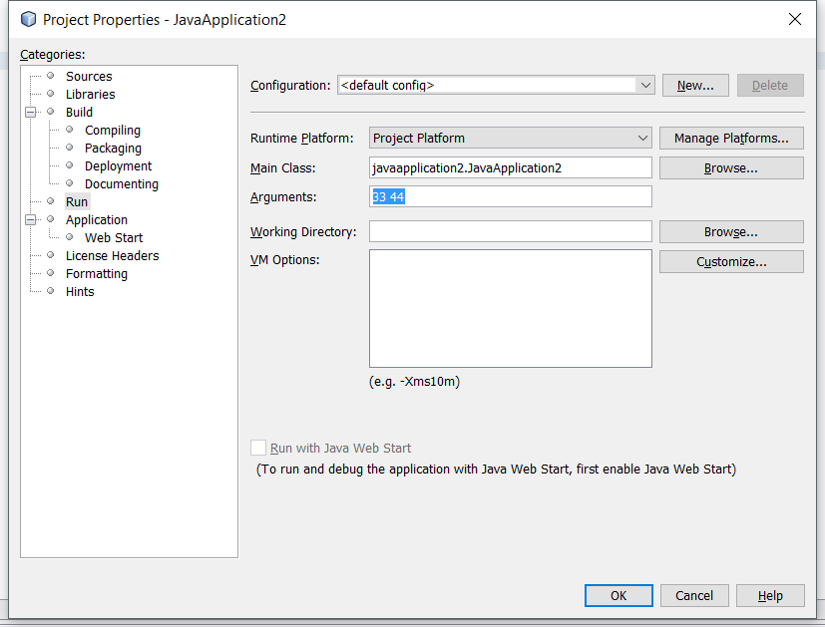
Using command arguments in netbeans

Slide 10
Characteristics
Part 1 – Introduction to Java virtual machine

Slide 11
Programming languages:
Compiled languages: C, C++
Interpreted languages: PHP, JavaScript
Hybrid languages: Java, Python, C#
Notes:
Examples of software/languages we can use to make games

Slide 12
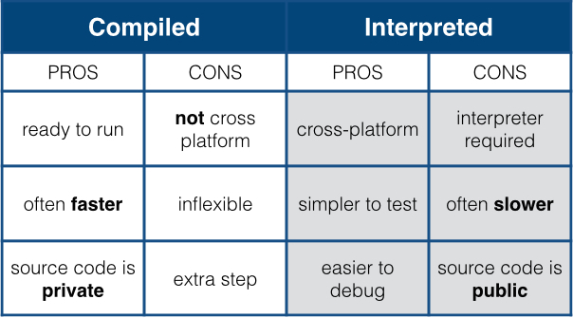
Compiled vs Interpreted languages
A compiled language is when a person writes the code the compiler separates the file and the end result is an executable file. Basically, the owner keeps the source code.
Interpreted languages are different because the code is not compiled first hand. Instead, a copy is given to another machine and that machine interprets it. An example is JavaScript and PHP (which is used everywhere online).
Code
Compile Code
Run Compiled Code
Code
Run code

Slide 13
Java Is compiled & Interpreted
You need an interpreter to run Java programs.
Programs are compiled into the Java Virtual Machine(JVM) code called bytecode.
The bytecode is machine-independent and can run on any machine that has a Java interpreter, which is part of the JVM.

Slide 14
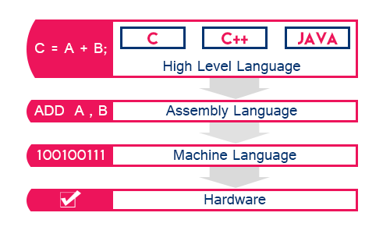
High to low level languages
Code must go from a high level language such as Java which humans can understand(Uses English language words)
To a machine language that the hardware can interpret(1’s and 0’s).
/bytecode
Notes:
Assemble language and bytecode are different but provide a middle ground between a high level language and machine code.

Slide 15
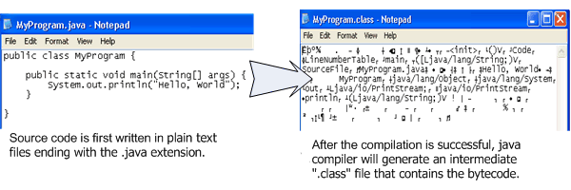
JVM is the Interpreter
Into machine code

Slide 16
C++ Comparison
Source code
Compiler
C Program
Machine Code

Slide 17
Java Is Interpreted continued
C++ and most compilers
Java
Translate programs in a high-level language to machine code.
The code can only run on the native machine. If you run the program on other machines, it has to be recompiled on the native machine.
For instance, if you compile a C++ program in Windows, the executable code generated by the compiler can only run on the Windows platform.
You compile the source code once, and the bytecode generated by a Java compiler can run on any platform with a Java interpreter(JVM).
The Java interpreter (JVM). translates the bytecode into the machine language of the target machine.

Slide 18
Multiplatform or Architecture-Neutral
Java is called a write once run anywhere programming language. JVM makes this possible.
Your Java program can run on any platform as long as the interpreter is installed
Java programs can be standalone or run in web browsers(Applets)
Software vendors usually develop multiple versions of the same product to run on different platforms. With Java they only need to develop their software once.

Slide 19
Performance
This is criticized by some
The execution of the bytecode is never as fast as it would be with a purely compiled language, such as C++.
Because Java is interpreted, the bytecode is not directly executed by the system, but is run through the interpreter.
This is less of an issue with improvements to CPU’s and for most applications will not be noticeable.

Slide 20
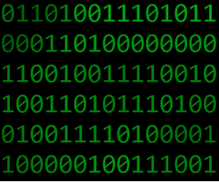
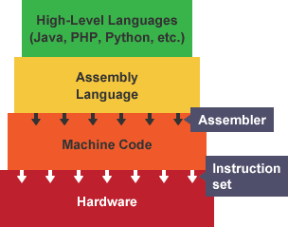
Performance – Just in time
To improve speed issues Oracle developed their JIT(Just-in-time) compiler
JIT compiler runs after the program has started and compiles the code (usually bytecode or some kind of VM instructions) on the fly (or just-in-time, as it's called) into a form that's usually faster, typically the host CPU's native instruction set(native machine code).

Slide 21
Characteristics
Part 2

Slide 22
Java class library
The Java Class Library (JCL) is a set of dynamically loadable libraries that Java applications can call at run time. Popular libraries include:
Text: java.text deals with text, dates, numbers, and messages.
Image package: java.awt.image and javax.imageio provide APIs to write, read, and modify images.
Applets: java.applet allows applications to be downloaded over a network and run within a guarded sandbox
GUI and 2D Graphics: the AWT package (java.awt) and Swing package (javax.swing) provide basic GUI operations and binds to the underlying native system. It also contains the 2D Graphics API.
User input: java.util.Scanner allows for program users to enter data
http://docs.oracle.com/javase/7/docs/api/index.html

Slide 23
Java Is (Relatively) Simple
No language is simple, but Java is a bit easier than the popular object-oriented programming language C++,
Java is partially modeled on C++, but greatly simplified and improved.
Java uses automatic memory allocation and garbage collection(Removes unused objects), whereas C++ and C requires the programmer to allocate memory and collect garbage.
Clean syntax makes Java programs easy to write and read.

Slide 24
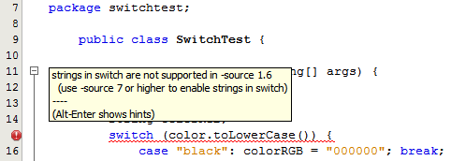
Error handling – Compile errors
Errors often happen creating software
Java checks your code when compiling to make sure you are using the correct syntax.
IDE(Integrated Developer Environments) such as Netbeans also do this in real time as you write your code.

Slide 25
Error handling - Exception Handling
If the error occurs during runtime Exception handling can be used in our code.
Such as a user entering an invalid input, the code trying to contact a external system which won’t respond or simply a programming error. Try-Catch-Finally is one example of a exception handling implementation.
1st a try block that encloses the code section which might throw an exception,
2nd one or more catch blocks that handle the exception and
3rd a finally block which gets executed after the try block was successfully executed or a thrown exception was handled.

Slide 26
Syntax – try-catch-final
Examples of exceptions include a FileNotFoundException and IOException (Input or output error, could be user entry).
To use exceptions we use “import java.io.*;”

Slide 27
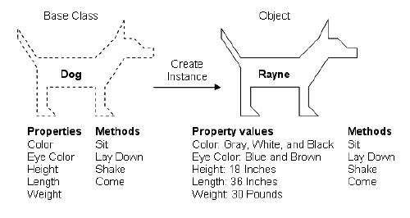
Object-Oriented
Designed from the start to be object oriented.
Object-oriented programming models the real world in terms of objects. Everything in the world can be modeled as an object.
A circle is an object, a person is an object, and a Window icon is an object. Even a loan can be perceived as an object.
A Java program is object-oriented because programming in Java is centered on creating objects, manipulating objects, and making objects work together.
The alternative is procedural programming(A systematic order of statements, functions and commands)

Slide 28
Object-oriented Continued
OOD helps organize code/visual scripting by organizing it into what are known as objects. Objects hold information about state and behaviour:
States are the characteristics of the object, or the words you would use to describe it, and usually take the form of is or has descriptors. A computer is either on or off, a chair has four legs, and you have a name.
Behaviours are the things the object can do, or the actions the object can perform, and are usually verbs that end in ing. You are sitting, using a computer, and reading.

Slide 29
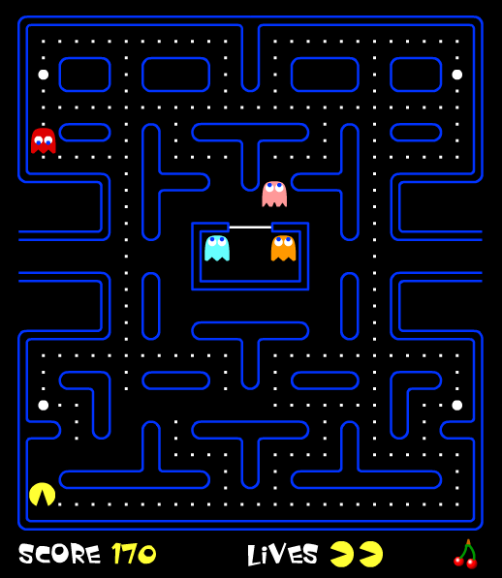
Object-oriented Example
For Pac-Man, there are three objects: Pac-Man, a ghost, and a pac-dot.
The ghost has states of:
colour
name
state (eatable or not)
direction
speed
and behaviours of:
moving
changing state

Slide 30
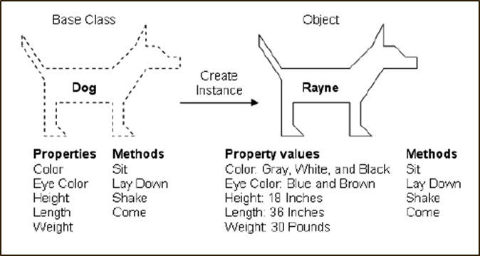
OO Programming example:
Properties(State)
Methods(Behaviour)

Slide 31
OOD vs procedural
Procedural programming uses a list of instructions to tell the computer what to do step-by-step. Procedural programming relies on, also known as routines or subroutines. A procedure contains a series of computational steps to be carried out.
Procedural code is quicker
OOD is easy to re-use code

Slide 32
Portable
Because Java is works on multiple platforms, Java programs are portable.
They can be run on any platform without being recompiled.
The Java environment is portable to new hardware and operating systems.
In fact, the Java compiler itself is written in Java.

Slide 33
Robust
Robust means reliable.
No programming language is completely reliable but Java has implemented strong error detection
Emphasis on early checking
Java compilers can detect many problems that would first show up at execution time in other languages.
Java has a runtime exception-handling feature to provide programming support for robustness.
The programmer is forced to write the code to deal with exceptions.

Slide 34
Secure
As an Internet programming language, Java is used in a networked and distributed environment.
Malicious Java applets for example, when run in your browser can not damage your system because Java implements several security mechanisms to protect your system against harm caused by stray programs.
The security is based on the premise that nothing should be trusted.
More extensive information here: https://www.oracle.com/technetwork/java/javase/jaas/index.html

Slide 35
Distributed
Distributed computing involves several computers working together on a network.
Java is designed to make distributed computing easy.
Since networking capability is inherently integrated into Java, writing network programs is like sending and receiving data to and from a file.

Slide 36
Multithreaded & Concurrency
Multithreading is a program’s capability to perform several tasks simultaneously.
For example, downloading a video file while playing the video would be considered multithreading.
Multithread programming is smoothly integrated in Java, whereas in other languages you have to call procedures specific to the operating system to enable multithreading.
Multithreading is particularly useful in graphical user interface (GUI) and network programming. In GUI programming, there are many things going on at the same time.

Slide 37
Multithreaded & Concurrency
When programmers write code, a programmer views the code (sequenced set of instructions to computer) as a single thread of execution, weaving through the code. Do A Do B Do C Do D What multi-threaded paradigm allows for is the ability for a programmer to write code like this... Do A and Do B Do C Do D Here task A and B happens concurrently or could even happen in parallel. So there are multiple threads of execution with a single application.

Slide 38
Syntax & standards

Slide 39
Java Program Structure
In the Java programming language:
A program is made up of one or more classes
A class contains one or more methods
A method contains program statements
A Java application always contains a method called main
main is the first method called when a Java application starts

Slide 40
Java Program Structure
// comments about the class
public class MyProgram
{
}
class header
class body
Comments can be placed almost anywhere

Slide 41
Java Program Structure
// comments about the class
public class MyProgram
{
}
// comments about the method
public static void main (String[] args)
{
}
method header
method body

Slide 42
Identifiers
Identifiers are the words a programmer uses in a program (variable names, class names, method names…)
An identifier can be made up of letters, digits, the underscore character ( _ ), and the dollar sign
Identifiers cannot begin with a digit
Java is case sensitive - Total, total, and TOTAL are different identifiers
By convention, programmers use different case styles for different types of identifiers, such as
title case for class names - Lincoln
upper case for constants - MAXIMUM

Slide 43
Reserved Words are predefined in the language, and cannot be used as identifiers
The Java reserved words:
abstract
assert
boolean
break
byte
case
catch
char
class
const
continue
default
do
double
else
enum
extends
false
final
finally
float
for
goto
if
implements
import
instanceof
int
interface
long
native
new
null
package
private
protected
public
return
short
static
strictfp
super
switch
synchronized
this
throw
throws
transient
true
try
void
volatile
while

Slide 44
White Space
Spaces, blank lines, and tabs are called white space
White space is used to separate words and symbols in a program
Extra white space is ignored in Java
A valid Java program can be formatted many ways
Programs should be formatted to enhance readability, using consistent indentation

