Slide 1
Understanding Theory and application of 3D
Displaying 3D polygon animations
James Tedder

Slide 2
application programming interface
Microsoft Direct3D: Part of the DirectX package and a competitor to openGL. It is an application programming interface (API) which renders 3D objects. Designed to speed up 3D rendering within Windows. All mainstream graphics cards support it.
OpenGL: Open Graphics Library is a cross-language, cross-platform application programming interface (API)

Slide 3
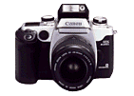
Graphics pipeline
Graphics Pipeline
Framebuffer
Maya 3D scene, Camera
Parameters, and
light sources
Display

Slide 4
Graphics pipeline - Simplified
To make a 3-D image, the graphics card has to:
Create a wire frame out of straight lines.
Rasterizes the image (fills in the remaining pixels).
Then it also adds lighting, texture and colour.
For fast-paced games, the computer has to go through this process about sixty times per second. Without a graphics card to perform the necessary calculations, the workload would be too much for the computer to handle.

Slide 5
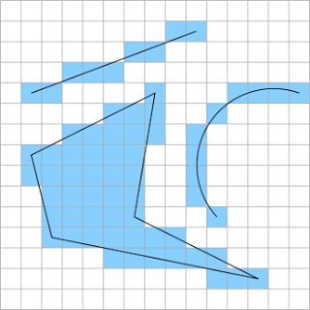
Rasterisation
Rasterization is the process of converting from polygons to pixels on the screen.
It looks to determine what pixel is part of what polygon and the fills that pixel in with that polygons color or texture.
As you can see the edges aren't very pretty, those jaggies are caused by the fact that the screen resolution isn't high enough to properly display the art we want.
The effect is called aliasing and the process of removing it is known as anti-aliasing.

Slide 6
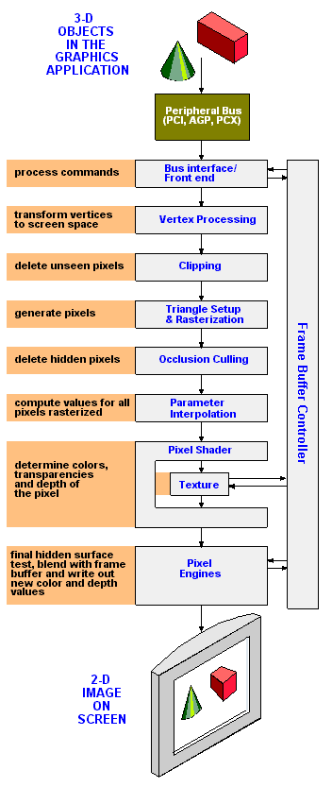
graphics pipeline - Expanded
Stages required to transform a three-dimensional image into a two-dimensional screen. (Vector to Pixels)
Bus interface/Front End Interface to the system to send and receive data and commands.

Slide 7
graphics pipeline
2. Vertex Processing/Shader Converts each vertex into a 2D screen position, and lighting may be applied to determine its color. 3. Clipping This removes the parts of the image that are not visible in the 2D screen view such as the backsides of objects or areas that the application or window system covers.

Slide 8
graphics pipeline
4.1 Primitive Assembly, Triangle Setup Vertices are collected and converted into triangles. 4.2 Rasterization The triangles are filled with pixels known as "fragments”. 5. Occlusion Culling Removes pixels that are hidden (occluded) by other objects in the scene.

Slide 9
graphics pipeline
7. Parameter Interpolation The values for each pixel that were rasterized are calculated, based on color, fog, texture, etc. 8. Pixel Shader This stage adds textures and final colors to the fragments. Also called a "fragment shader“.

Slide 10
graphics pipeline
9. Pixel Engines Mathematically combine the final fragment color, its coverage and degree of transparency with the existing data stored at the associated 2D location in the frame buffer to produce the final color for the pixel to be stored at that location.

Slide 11
graphics pipeline
10. Frame Buffer Controller The frame buffer controller interfaces to the physical memory used to hold the actual pixel values displayed on screen. The frame buffer memory is also often used to store graphics commands, textures as well as other attributes associated with each pixel.

Slide 12
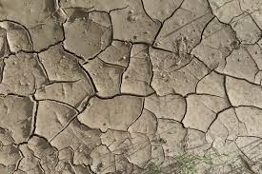
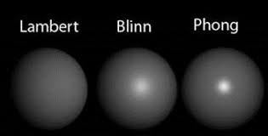
Texture vs shader
Textures are 2D images
Shaders (Known as materials in Maya) determine the way in which light affects it - in other words, it determines the falloff, absorption and reflection of light

Slide 13
Applying Shaders - Lambert
Lambert is a flat material type that yields a smooth look without highlights.
It calculates without taking into account surface reflectivity, which gives a matte, chalk-like appearance.
Lambert material is ideal for surfaces that don't have highlights: pottery, chalk, matte paint, and so forth.
By default, any newly created object gets the Lambert shader assigned to it.

Slide 14
Applying Shaders - Blinn
The Blinn material type calculates surfaces similarly to Phong, but the shape of the specular highlights in Blinn materials reflects light more accurately.
Blinn is good for metallic surfaces with soft highlights, such as brass or aluminium.

Slide 15
Applying Shaders - Phong
The Phong material type takes into account the surface curvature, amount of light, and camera angle to get accurate shading and highlights.
The algorithm results in tight highlights that are excellent for polished shiny surfaces, such as plastic, porcelain, and glazed ceramic.

Slide 17
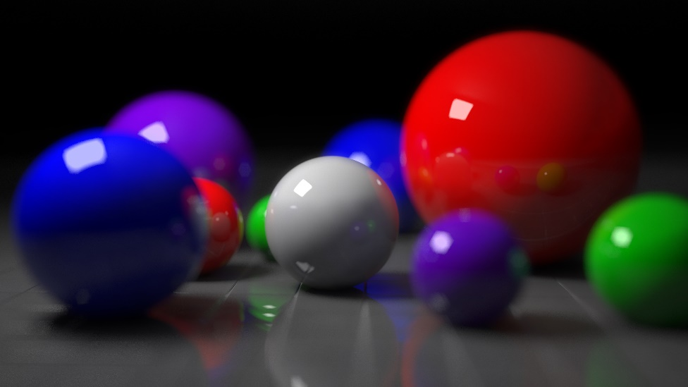
rendering techniques
Ray tracing
Provides realistic simulation of lighting over other rendering methods. Effects such as reflections and shadows, which are difficult to simulate using other algorithms, are a natural result of the ray tracing algorithm
Models specular(Mirror like) reflection well, but diffuse reflection(reflection of light) is approximated
Notes:
Ray Tracing and Radiosity can be combined

Slide 18
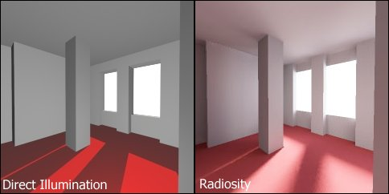
rendering techniques
Radiosity
Models diffuse reflection(reflection of light) accurately, but specular reflection (Mirror like) is ignored.

Slide 19
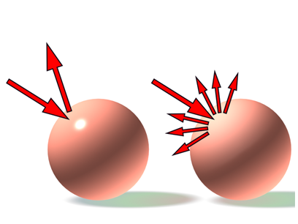
Types of reflection
Specular reflection
(Ray tracing)
Diffuse reflection
(Radiosity)
Notes:
Specular reflection (Ray tracing) = Mirrored lighting and reflection
Diffuse reflection (Radiosity) = But ignores reflection

Slide 20
Radiosity & raytracing
Traditionally radiosity has been for games while ray tracing has been for still images, film & TV). However that is changing with new more powerful graphics cards.
DirectX Raytracing tech demo - accurate real-time reflections. https://youtu.be/81E9yVU-KB8
Reflections Real-Time Ray Tracing Demo. https://youtu.be/J3ue35ago3Y

Slide 21
rendering engines
Converting 3D wire frame models into 2D images on a computer. There are many rendering engines that can be added as plug ins to Maya. Including:
Mental Ray: Supports and uses Ray Tracing. Used in The Matrix Reloaded & Revolutions amongst others
Arnold: Based on Ray Tracing tech, used in a number of films including Elysium, Pacific Rim and Gravity.
Others include: V-Ray, Maxwell and Render Man(Created by Pixar)

Slide 22
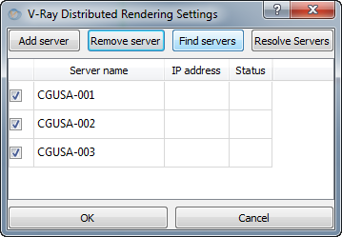
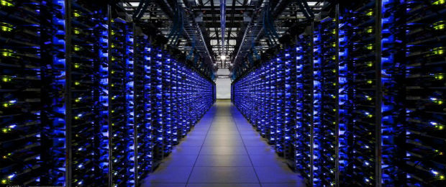
distributed rendering techniques
Distributed rendering is a technique for distributing a single render job within a single frame across many computers in a network.
Could also refer to multiple graphics cards or CPU’s built into a single PC.

Slide 23
Lighting
Indirect (Global illumination)
Indirect light is all the inter-reflected light in a scene. Global illumination is an approximation of real-world indirect light transmission.
Examples:
A crack at the bottom of a door can cause light to spill into a room.
White walls reflect light from the light source to another surface in a room.
A body of water can transmit light from its surface to the floor.

Slide 24
Lighting
Local illumination (Light sources)
Local illumination is only the light provided directly from a light source (such as a spot light).
Light reflected once off a surface towards the eye
Examples:
A spot light illuminates an actor on stage
Sunlight shines directly on sunbathers

Slide 25
Local vs Global illumination
Local Illumination
Global Illumination
Notes:
Local: Light only reflects off one(Local Object)
Global: Reflects off all objects within the scene creating greater realism

Slide 26
shadow mapping

