Slide 1
Introduction to programming algorithms

Slide 2
Programming - Purpose, structure and the outline of a program.
An overview – programming is:
analysis of a scenario/problem
defining a specification
identifying input, process and output testing/debugging.

Slide 3
Input–process–output (IPO)
This model is a widely used approach for describing the structure of an information processing program or other process.
This is the most basic structure for describing a process.
A requirement from the environment (input)
e.g. take users age.
A computation based on the requirement (process)
e.g. process that age and calculate correct wage for age group.
A provision for the environment (output)
e.g. output that on screen to the user.

Slide 4
Defining an algorithm
“A process or set of rules to be followed in calculations or other problem-solving operations, especially by a computer.” dictionary.com

Slide 5
What is an algorithm?
An algorithm is a sequence of instructions or a set of rules that are followed to complete a task. This task can be anything, so long as you can give clear instructions for it.
For example, to make yourself a drink you have to follow a sequence of steps in the right order.
If you don’t get a glass before pouring the drink you’re going to have a clean up on your hands!
The process must be done in a set order
This is how algorithms work.
Consider the statements and conditionals(E.g IF-ELSE, FOR, WHILE) we have looked at within Java.

Slide 6
An algorithm has…
Finiteness - The process terminates, the number of steps are finite
Definiteness - Each step is precisely stated
Effective computability - Each step can be carried out by a computer

Slide 7
An algorithm contains…
There are three basic constructs in an algorithm:
Linear Sequence: A progression of tasks or statements that follow one after the other.
Conditional: IF-THEN-ELSE a decision is made between two course’s of actions.
Loop: WHILE and FOR are sequences of statements that are repeated a number of times.

Slide 8
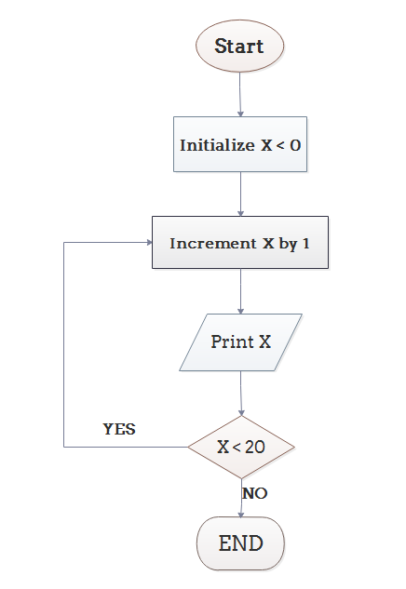
Simple algorithm example
Step 1: Initialize X as 0,
Step 2: Increment X by 1,
Step 3: Print X,
Step 4: If X is less than 20 then go back to step 2.

Slide 9
Sorting algorithms
Takes data and sorts it into a list defined by the algorithm
Examples include:
Quick Sort
Insertion Sort
Radix Sort
Heap Sort
Bubble Sort
Merge Sort
Counting Sort

Slide 10
Sorting algorithms example – Bubble Sort
In this sorting algorithm as elements are sorted they gradually "bubble" (or rise) to their proper location in the array, like bubbles rising in a glass of soda.
It begins at the start of the array and compares the first and the second numbers.
If the number is higher than the second one then swap the two numbers.
Then repeat this for the number that is at the second place now, then the third, and so on.
Notes:
Bubble Sort – Code example: https://www.javatpoint.com/bubble-sort-in-java

Slide 11
Bubble Sort – How it works
First Pass: ( 5 1 4 2 8 ) –> ( 1 5 4 2 8 ) ( 1 5 4 2 8 ) –> ( 1 4 5 2 8 ) ( 1 4 5 2 8 ) –> ( 1 4 2 5 8 ) ( 1 4 2 5 8 ) –> ( 1 4 2 5 8 )
Second Pass: ( 1 4 2 5 8 ) –> ( 1 4 2 5 8 ) ( 1 4 2 5 8 ) –> ( 1 2 4 5 8 ) ( 1 2 4 5 8 ) –> ( 1 2 4 5 8 ) ( 1 2 4 5 8 ) –> ( 1 2 4 5 8 )
Third Pass: ( 1 2 4 5 8 ) –> ( 1 2 4 5 8 ) ( 1 2 4 5 8 ) –> ( 1 2 4 5 8 ) ( 1 2 4 5 8 ) –> ( 1 2 4 5 8 ) ( 1 2 4 5 8 ) –> ( 1 2 4 5 8 )
1st(5) and 2nd(1) are ordered into lowest number first.
Then 2nd(5) and 3rd(4). Again they are sorted. This continues for the length of the array.
Then starts again for as many passes as it needs.
Note for the third pass that the array is already sorted but the algorithm doesn’t realise.
The algorithm needs one whole pass without any swap to know it is sorted.
Original array: 5 1 4 2 8
Sorted array: 1 2 4 5 8

Slide 12
Brute force vs algorithms
Brute force definition:
Solves a problem in the most simple, direct, or obvious way
Not distinguished by structure or form
Tries a large number of patterns to solve a problem.
Pros
Often simple to implement
Cons
May do more work than necessary – May be efficient (but typically is not)

Slide 13
Analysing efficiency: algorithms performance vs brute force.
Bubble Sort uses the Brute Force Approach.
Consider that it will keep running till the end even if it has actually sorted the array into the correct order.
The alternative to brute force is Dynamic Programming.
The core idea of Dynamic Programming is to avoid repeated work by remembering partial results and this concept finds it application in a lot of real life situations.
Rather than having one way of solving a problem it creates several smaller problems(sub-problems) based on the initial issue.
These sub-problems are each run and the outcome stored in memory.

Slide 14
Dynamic Programming - Analogy
1+1+1+1+1+1+1+1 What does this equal?
Eight
If we add"1+" on the left. What does this equal?
Nine
How'd you know it was nine so fast?
We just added one more
So you didn't need to recount because you remembered there were eight!
Dynamic Programming is just a fancy way to remembering stuff to save time later!

Slide 15
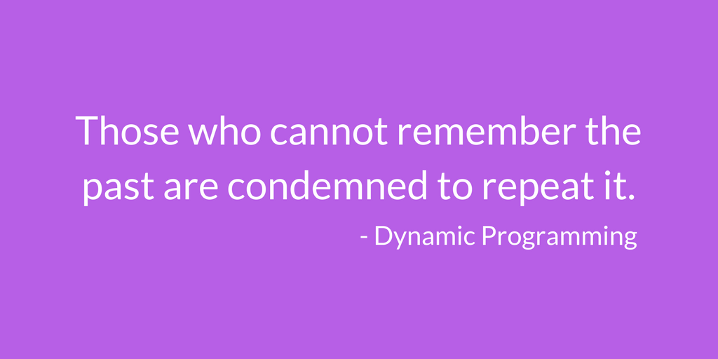
Research the theory of Dijkstra's algorithm for your assignment and use as an example.

Slide 16
Encryption/decryption algorithms
Encryption refers to any process used to make sensitive data more secure and less likely to be intercepted by those unauthorized to view it.
A cryptographic algorithm, or cipher, is a mathematical function used in the encryption and decryption process.
A cryptographic algorithm works in combination with a key — a word, number, or phrase — to encrypt the plaintext.
The same plaintext encrypts to different ciphertext with different keys.

Slide 17
Ciphertext - Encryption/decryption algorithms
Plain English(or other language) data that can be easily read are called plaintext.
Encrypted data is called ciphertext
Public key
Private key
Notes:
Public keys may be spread widely, and private keys which are known only to the owner.
Both keys needed decryption.

Slide 18
Keys - Encryption/decryption algorithms
Base
Power
8²
The power of a number says how many times to use the number in a multiplication.
It is written as a small number to the right and above the base number.
In this example:
8² = 8 × 8 = 64
So
8³ = 8 × 8 x 8 = 512
A key is a value that works with a cryptographic algorithm to produce a specific ciphertext.
They are measured in bits.
The bigger the key, the more secure the ciphertext.
Let’s use 128 Bit encryption as an example
It would take 2¹²⁸ different combinations to break the encryption key.
That’s 340,282,366,920,938,463,463,374,607,431,768,211,456 different combination attempts!
1 bit has a single binary value, either 0 or 1

Slide 19
Basic example of encryption - Caesar Cipher
For this algorithm the key is the number of characters to shift the cipher alphabet.
Here is a quick example of the encryption and decryption steps involved with the Caesar Cipher.
The text we will encrypt is 'defend the east wall of the castle', with a shift (key) of 1.
plaintext: defend the east wall of the castle
ciphertext: efgfoe uif fbtu xbmm pg uif dbtumf
Notice each letter in plaintext is replaced by the next in the alphabet in the ciphertext. This is because of the key!

Slide 20
Encryption/decryption algorithms –Examples
1. DES - Key size of 56-bit
2. Triple DES - Key size of 112/168
3. AES - Key size of 128-bit, 198-Bit and 256-bit
4. Blowfish - Key size of 128-bit up to 448-bit.
5. Twofish – New version of blowfish. Key sizes up to 256 bits.
6. RC4 - Key size from 40-bit to 1024-bit, RC4.
Fastest java supported encryption algorithm.
Notes:
Research and consider speeds of these for your assignment.

Slide 21
Compression/decompression algorithms
The process of reducing the size of a data file is often referred to as data compression.
Compression can be either lossy or lossless.
Lossless compression reduces bits by identifying and eliminating statistical redundancy(wasted "space"). No information is lost in lossless compression.
Lossy compression reduces bits by removing unnecessary or less important information

Slide 22
Compression/decompression – Algortihm Examples
Lossless Examples:
DEFLATE –Used by ZIP, gzip, and PNG images.
Lempel–Ziv–Markov chain algorithm (LZMA) – Used by 7zip and xz.
Lempel–Ziv–Oberhumer (LZO) – Designed for speed at the expense of compression ratios.
Lossy Examples(Used with audio and film, never for data/text):
JPEG - Pictures
MPEG - Video
MP3 - Audio

Slide 23
Assignment 1 should include:
Pass | Merit | Distinction
LO1 Define basic algorithms to carry out an operation and outline the process of programming an application
P1 Provide a definition of what an algorithm is and outline the process in building an application. | M1 Determine the steps taken from writing code to execution. | D1 Examine the implementation of an algorithm in a suitable language. Evaluate the relationship between the written algorithm and the code variant.
Purpose and structure and the outline of a program in Java. Include mentions of package, class, methods, statements, syntax.
Discuss input, process and output(IPO) of programming including an example.
Identifying methods, variables, constants, scope(Public, private, protected, default), relating to an algorithm implementation.
M1 Must include a discussion on how Java programs are compiled and interpreted(JVM).
An introduction to algorithms; what is an algorithm? Define it. Why use algorithms?
Examine a range of algorithms for various purposes including:
sorting algorithms, encryption/decryption or compression/decompression
A look at the code implementation of common algorithms in Java. E.g. Bubble sort + D1 any other algorithm explained from theory to code.
Analysing efficiency: their performance against brute force.
Use of Big O notation
Cost of running time, acknowledgment of hardware performance as a factor.
Create and present a presentation
Hand in: Notes(500 words) and Power Point
Notes:
Pass:
Theory of algorithms to be explained including theory based examples and theory understanding of building an application. Big O notation to be implemented and explained at least once.
Merit:
Identifying input, process and output testing/debugging. The roles of the pre-processor, compiler and linker, interpreter(JVM). Use an example.
Distinction guidance:
Only one practical application needed in Java for distinction but must be explained well, show clear understanding and link the theory to practice. Cannot use bubble sort. Recommend Insertion Sort and Selection Sort.
Code does not need to be written by learner but will be clearly understood.
LO1 Define basic algorithms to carry out an operation and outline the process of programming an application
Algorithm definition: Writing algorithms to carry out an operation, e.g. Bubble sort.
The relationship between algorithms and code.
The generation process of code; the roles of the pre-processor, compiler and linker, interpreter.

