Slide 1
Games Engines and Intro to Programming

Slide 2
Starter exercise – 15 Mins
List and name as many game engines as you can. There are many.
Find and list some popular games made with those engines.

Slide 3
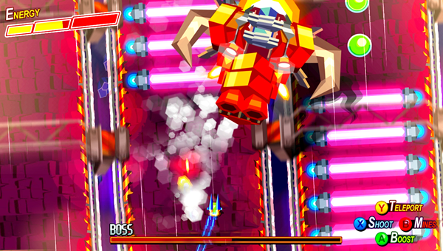
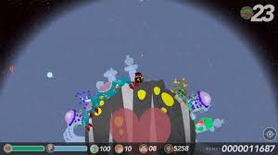
Gamemaker:
  Undertale
  Hyper Light Drifter
  Hotline Miami
Unity:
  Cuphead
  Rick and Morty: Virtual Rick-ality
  Inside (By Playdead)
  Hearthstone
Unreal Engine:
  Fortnight
  Spyro Reignited Trilogy
  PUBG
Amazon Lumberyard:
  Star Citizen
Construct 2
  The Next Penelope
  Cosmochoria
  Insanity's Blade

Slide 4
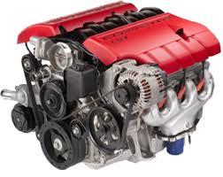
Game Engines 101.
A game engine is the program we use to build the game world.
Its where the games interactivity comes from.

Slide 5
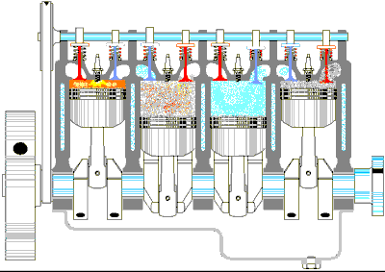
Game Engines 101.
Much like a car engine its made of lots of different parts, which all spin separately but when put together they make things happen.
Its where the games interactivity comes from.

Slide 6

Interactivity is the key concept for games development.
What does interactivity mean?
An action, caused by something else’s influence.

Slide 7
All games are built on interactivity
Lets look at Angry Birds….
http://www.youtube.com/watch?v=9niqSk9VCi8
What happens when the player pulls their finger back?
What happens when they release their finger?
What happens when the bird hits the buildings?
What happens when the bird hits all the pigs?

Slide 8
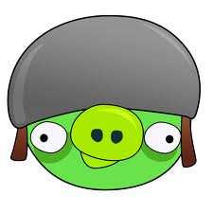
INTERACTION
When I do (A) then (B) happens.
When the (bird hits the pig) then (the pig dies).

Slide 9
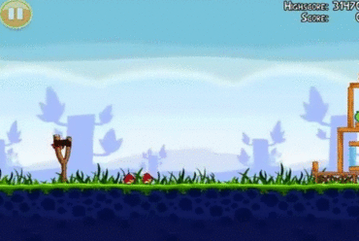
Interaction drives the game forward

Slide 10
What is a game engine?
A game engine is a software framework designed for the creation and development of video games. Developers use them to create games for consoles, mobile devices and personal computers.
Set of tools to assist in making a game
Game agnostic software components (Can link and work with other software)
Reusable for many different games
Multi-platform (typically)
Allows for data driven development (flow of the program is determined by events such as user actions)
Makes development faster!

Slide 11
Engine toolsets include:
Renderer (2D or 3D)
Collision Detection
Scripting
Sound/Video
Animation
Shading/Lighting
Networking
Physics
Artificial Intelligence
Level Editor
Custom Tools

Slide 12
Digital Content Creation Tools
Games are multimedia applications by nature.
A game engine’s input data comes in a wide variety of forms, from 3D mesh data to texture bitmaps to animation data to audio files.
All of this source data must be created and manipulated by artists.
The tools that the artists use are called digital content creation (DCC) applications.
DCC applications for games development engines include:
  Photoshop(Texture editing)
  Piscal(Sprite Creation)
  3D Modelling software and animation software(e.g Autodesk Maya3D Studio Max)
  Sound editing software (E.g )Audacity

Slide 13
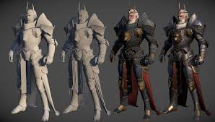


Digital Content Creation Tools Continued
Used to create anything other than the code. These are called assets and include anything used by the:
  Render Engine
  Sound/Video Engine
  Animation Engine
Which would include:
  Models
  Textures
  Sounds
  Videos
  Animations

Slide 14
So….
Game engines stream line the game making process
Allow us a place to create interactivity for our game
Allow us a central place to collect, store, place and use our assets
Allow us to create platform independent games (Usually)
Game engines are fundamentally built on programming languages however. Even if a tree based system is in place such as Construct 2….

Slide 15
Exercise – 10mins
What programming language do the following use:
Construct 2:
Gamemaker:
Unity:
Unreal Engine:
Amazon Lumberyard:
Android SDK:
IOS SDK:

Slide 16
Exercise – 10mins
What programming language do the following use:
Construct 2: Tree based system(HTML5-based engine)
Gamemaker: GML (Similar to C)
Unity: C#
Unreal Engine: C++ (+ proprietary blueprints – Creates C++)
Amazon Lumberyard: C++
Android SDK: Officially Java, unofficially many other languages
IOS SDK: Objective-C (Version of C)

Slide 17
What is a programming language
A special computing based language that programmers use to develop software programs, scripts, instructions and games for computers and consoles to execute.
Like all the spoken languages throughout the world there are many different programming languages

Slide 18
Application software for games:
Game Engines:
Gamemaker, Unity and Unreal etc
Languages for games
Hybrid languages: Java, Python, C#
Compiled languages: C, C++
Interpreted languages: PHP, JavaScript
Game engines and programming languages are intrinsically linked
Notes:
Examples of software/languages we can use to make games
W

Slide 19
To compare let’s take a look at the programming language Java
More than 3 billion devices run Java.
Java is used to develop apps for Google's Android OS, various Desktop Applications, such as media players, antivirus programs, Web Applications, Enterprise Applications (i.e. banking), and many more!

Slide 20
Netbeans IDE(Integrated Development Environment)
Similar to Visual Studio used with the Unreal Engine and Unity
Customize the coding environment exactly the way you want – choose your favorite theme, color, fonts, and all the other settings.
Browse coding project through file structures.
Compiles and runs our code at a button press
Comprehensive debugging and error detection

Slide 21
Java Program Structure
In the Java programming language:
  A program is made up of one or more classes
  A class contains one or more methods
  A method contains program statements
A Java application always contains a method called main
main is the first method called when a Java application starts

Slide 22
Java Program Structure
// comments about the class
public class MyProgram
{
}
class header
class body
Comments can be placed almost anywhere

Slide 23
Java Program Structure
// comments about the class
public class MyProgram
{
}
// comments about the method
public static void main (String[] args)
{
}
method header
method body

Slide 24
Creating a Variable
A variable in java is a useful container which a value can be stored in and used within the program.
The stored value can then be changed (vary) throughout the program as it executes its instructions.
A variable is created by writing a variable declaration in the program specifying the type of data that the variable can contain.

Slide 25
2.1 Try this: Enter the following code. This code will create a variable and then modify it while outputting both values:
class FirstVariable { public static void main(String[] args) { String message = "Initial value"; System.out.println( message ); message = "Modified value"; System.out.println( message ); } }

Slide 26
3. Data Types
The most frequently used data types when declaring a variable are shown below:
Data type: | Description: | Example:
char | A single Unicode character | 'a'
String | Any number of Unicode characters | "This is my String"
Int | An integer number, between -2.14 billion and + 2.14 billion | 1000
float | A floating-point number, with a decimal point | 3.14159265f
boolean | A logical value of either true or false | true
Try this 3.1: Let’s create a program that creates, initializes and outputs variables of all the common data types

Slide 27
4. Creating constants
Constants allow you to declare a variable that cannot be changed.
Using the modifier "final" keyword before a data type lets the program know that no further changes are allowed.
Convention dictates that we use capital letters when declaring constants.
Try this 4.1 Using the code on the sheet let’s create a program that uses Constants
Try this 4.2 Add a statement that attempts to change the value of a constant, recompile and see what happens.

Slide 28
5. Comments
It is good practice when coding to leave comments to explain each section of your code. This helps yourself and other people to understand your code.
If you'd like to display code over multiple lines use /* and */ writing your comments in-between.
If you'd like to create a single line comment then start with //.
Comments are completely ignored by the compiler.
5.1 Try this: Add comments to your constants program

Slide 29
6. Exercises - A

Slide 30
6. Exercises - B

Slide 31
6. Exercises - C

