Slide 1
IDE’s and Debugging

Slide 2
IDE(Integrated Development Environment)
Designed to provide the facilities a programmers needs for software development
IDE’s provide a text editor, debugger and compiler all in one application.
Sometimes these can have more features than we need but are generally designed to make are coding experience as pleasant, customised and quick as possible.

Slide 3
IDE Examples
IDE’s include:
Netbeans - C, C++, Python, Perl, PHP, Java, Ruby and more
Eclipse - Java, JavaScript, PHP, Python, Ruby, C, C++ and more
Komodo - Perl, Python, Tcl, PHP, Ruby, Javascript and more
Visual Studio - Visual C++, VB.NET, C#, F# and others
Many others!

Slide 4
IDE: Some advantages
Look and feel customisation such as themes, fonts, colours etc.
Auto compiles and runs code
Folder Structure for the project
Provide Syntax highlighting
Automatic indentation for code blocks
Line numbers
Auto code completion
Auto code for inherited members
Provide debugging functionality, identifying syntax and obvious errors
Often provide GUI builders(Drag drop systems) for increased speed
Plug ins for additional functionality + more

Slide 5
IDE: Some negatives
Can create custom IDE code which is generalised and may not be compatible with other development software
Can cause incompatibility with other IDE’s
May require the IDE installed to run development code
Can cause dependence on IDE shortcuts, creating lazy developers
Uses greater system memory than text editors
Some require purchasing costs or licenses
Plug ins while useful don’t always provide full information about how the work

Slide 6
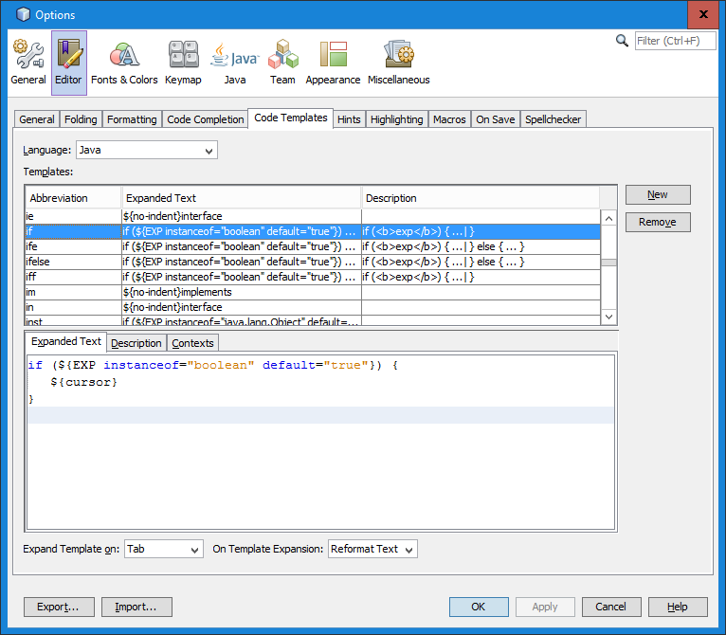
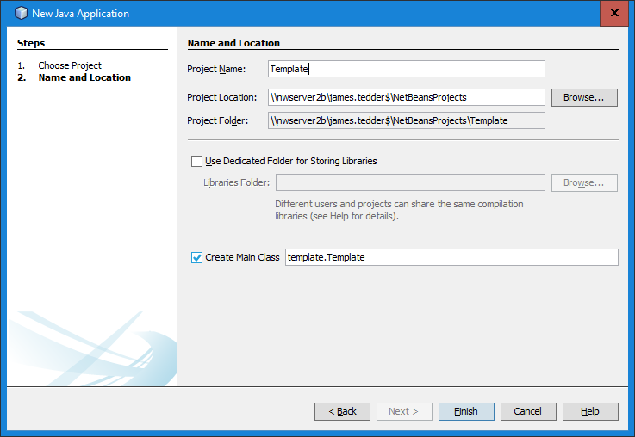
Code Templates
Allows the IDE to create templates for various functions such as conditionals.
The example opposite would put in a basic shell for a if statement if the programmer typed in “if” followed by tab on the keyboard.
Netbeans and other IDE’s offer many shortcuts
The first one most use is the main method which can be generated at project creation.

Slide 7
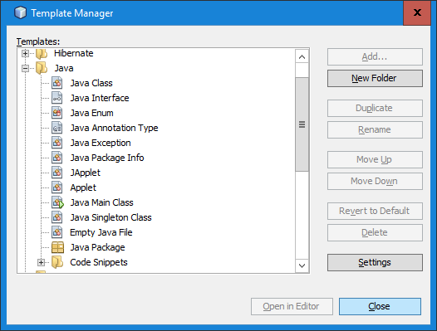
General Templates
You can also use the Template Manager to create entire files based on pre designed code by yourself
Or use/edit the basic built in one’s Netbeans provides.

Slide 8
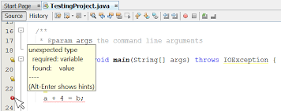
Debugging
The process of detecting and removing of existing and potential errors (also known as 'bugs') in a software code that can cause it to behave unexpectedly or crash.
To prevent incorrect operation of a software or system, debugging is used to find and resolve bugs or defects.

Slide 9
Debugging Process - Tracing
A technique of following (Tracing) your code line to line as the computer would. Working out exactly the values of variables throughout the program flow line by line.
Programmers do this to make sure the program makes sense and to identify errors in the code.
It can also be done to help understand another programmers code.

Slide 10
Debugging Process – Simple Tracing Example
String title =“HNC Computing";
int number = 370;
boolean result = true;
number = number - 5;
System.out.println( "Course is " + title);
System.out.println( "Days are " + number);
System.out.println( "Answer is " + result)
result = false;
System.out.println( "Answer is now" + result);
When tracing you’d go through the code making a note of all variables. As you go line by line you would update the value of the variable. This could be done on paper. An example for this simple program is below:
Char: J
String title: HNC Computing
int number = 370 365
boolean result: true false

Slide 11
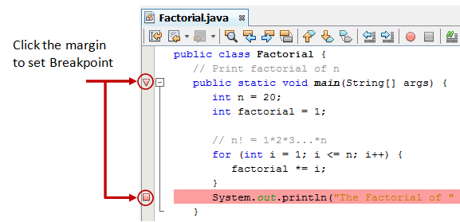
Debugging Process – Breakpoints
A line of code where you want to "pause" the execution of a program. This suspends the program allowing you to examine the code at this point of execution. Before starting the debugger, you need to set at least one breakpoint to suspend the execution inside the program.

Slide 12
Debugging Process – Watch Lists
Allows you to "watch" the value of a variable. For example, if you have a variable named "x", you can type x inside the watch window and watch the value as you go from breakpoint to breakpoint.
To add expressions to a watch list in NetBeans:
1. Click on the "Watches" tab at the bottom.
2. Type in a variable where it says <Enter new watch> to watch the name variable and press the enter button.

