Slide 1
Unit 2 - Networking
LO2 Networking devices and operations
Notes:
Networking devices: Servers; hub, routers; switches; multilayer switch, firewall, HIDS, repeaters; bridges; wireless devices; access point (wireless/wired), content filter, Load balancer, Modem, Packet shaper, VPN concentrator.
Networking software: Client software, server software, client operating system, server operating system, Firewall.
Server type: Web, file, database, combination, virtualisation, terminal services server.
Server selection: Cost, purpose, operating system requirement.
Workstation: Hardware e.g. network card, cabling; permissions; system bus; local-system architecture e.g. memory, processor, I/O devices.

Slide 2
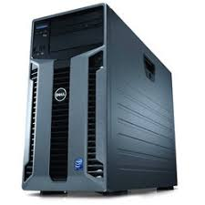
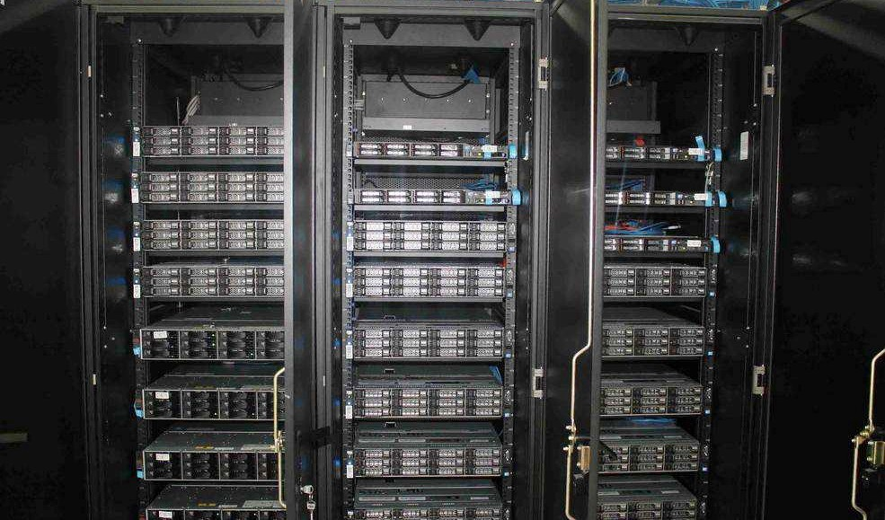
Networking devices: Servers
Tower Servers
Like traditional PC’s. A standalone machine that is built into an upright case.
Mostly in smaller datacenters.
Can be noisy and take up more physical than alternatives
Rack Servers
Mounted within a rack.
Uniform width and servers are mounted to the rack using screws.
Can accommodate multiple servers and the servers are typically stacked on top of each other.

Slide 3
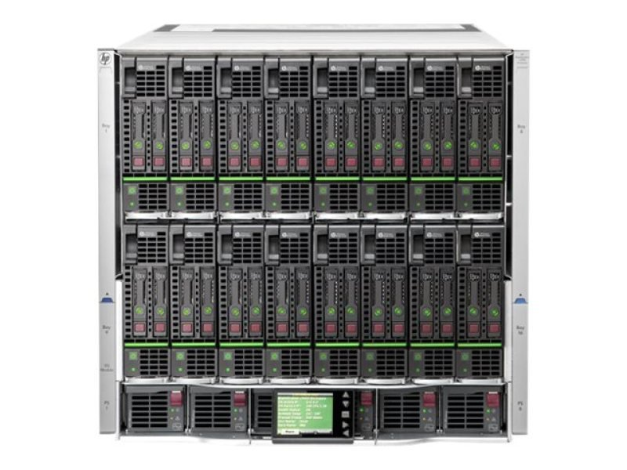
Networking devices: Servers
Blade Servers
Have standard size and mount inside a special “rack” known as a chassis.
Tend to be vendor proprietary. E.g. HP and Dell components will not work together.
Blade servers lack power supplies and other components
Accept various modular components such as a power supplies, storage units or the server.

Slide 4
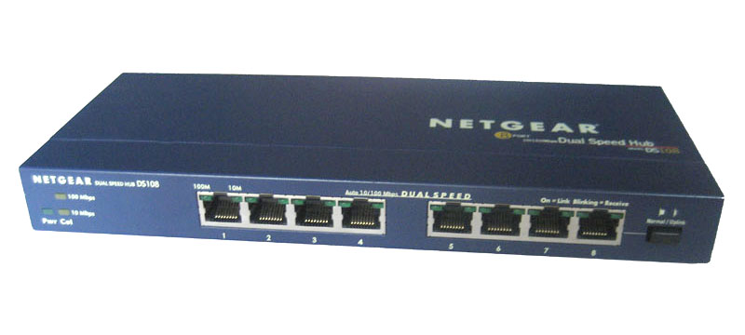
Networking devices: Hub
Hubs
Send data packets to all devices connected to the hub, regardless of whether the data package is destined for the device.
Inefficient because of this, performance bottlenecks can occur when busy.
Use twisted-pair cabling to connect devices.
Hubs also can be joined to create larger networks.
Does not perform any processing on the data it forwards, nor does it perform any error checking.
Switch’s are more advanced and have generally replaced HUB’s

Slide 5
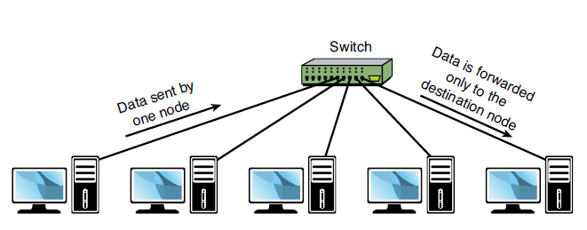
Networking devices: Switches; Multilayer switch
A basic switch works at:
OSI Layer 2 (the data link layer)
A multilayer switch works at:
Layer 2 and/or
OSI Layer 3 (the network layer).
Multilayer device can operate as both a
switch and a router.
Switches
Like hubs, switches are the connectivity points of an Ethernet network.
Devices connect to switches via twisted-pair cabling, one cable for each device.
The difference between hubs and switches is in how the devices deal with the data they receive.
Forwards data to only the port that connects to the destination device in contrast to a Hub.
It does this by learning the MAC address of the devices attached to it and then by matching the destination MAC address in the data it receives.
Greatly reduces traffic and collisions in contrast to a Hub.
Remember Collisions occur on Ethernet networks when two devices attempt to transmit at exactly the same time.

Slide 6
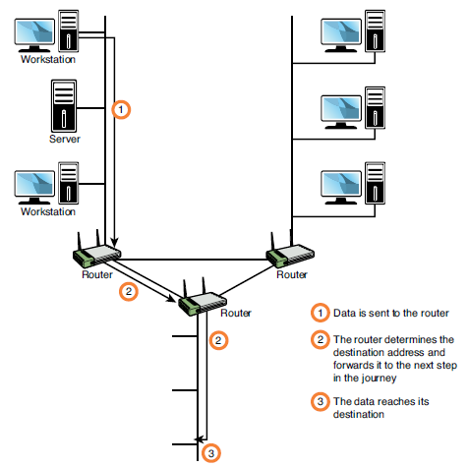
Networking devices: Routers
A router works at Layer 3 (the network layer) of the OSI model.
Normally routers work and forward data based on IP addresses
Routers
A router derives its name from the fact that it can route data it receives from one network to another.
In a common configuration, routers create larger networks by joining two network segments.
A small office, home office (SOHO) router connects a user to the Internet. A SOHO router typically serves 1 to 10 users on the system.

Slide 7
Networking devices: Firewall & HIDS
Host-Based Intrusion Detection System (HIDS):
Refers to applications such as spyware or virus applications that are installed on individual network systems. The HIDS monitors and creates logs on the local system.
Firewall
Either hardware- or software-based, that controls access to your organization’s network.
Protect data and resources from an outside threat. Typically placed at a network’s entry/exit points
E.g between an internal network and the Internet. After it is in place, a firewall can control access into and out of that point. Another example could be internal however such as between sales and accounts departments.
Many broadband routers and wireless access points have firewall functionality built in.
Often require minimal initial configuration but can be customized to restrict access on specific ports and IP addresses.

Slide 8
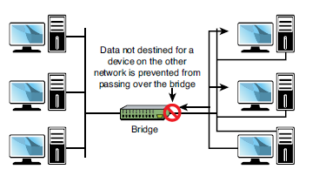
Networking devices: Repeaters; bridges
Repeaters
Receives a digital signal and sends the signal along the next leg of the network.
A series of repeaters make possible the extension of a signal over a distance.
Repeaters remove the unwanted noise in an incoming signal.
Bridges
Connect and divide network segments
Manage the flow of traffic between network segments
Works at the data link layer (OSI model layer 2)
Most bridges have only 2 or 4 ports. A switch can have hundreds of ports.
Looks at the destination of the packet before forwarding unlike a hub
A switch is more efficient in today's large networks

Slide 9
Networking devices: wireless devices; access point
Wireless devices
Such as tablets, phones, laptops, PC’s and most modern technology
Using standard IEEE 802.11 they connect to each other or a Wireless Access Point
Wireless Access point
Wireless APs are used to create a wireless LAN and to extend a wired network. APs are used in the infrastructure wireless topology.
APs also typically have several ports, giving you a way to expand the network to support additional clients.

Slide 10
Networking devices: Content filter, Load balancer.
Content filter
Any software that controls what a user is allowed to peruse and is most often associated with websites. E.g using a content filter, an employer can block access to pornographic sites to all users, some users, or even just an individual user.
Load balancer
A technique in which the workload is distributed between several servers. This feature can take networks to the next level; it increases network performance, reliability, and availability.
This is usual configured within your server firewall
This can be configured in the “Network load balancer manager” within Windows Server

Slide 11
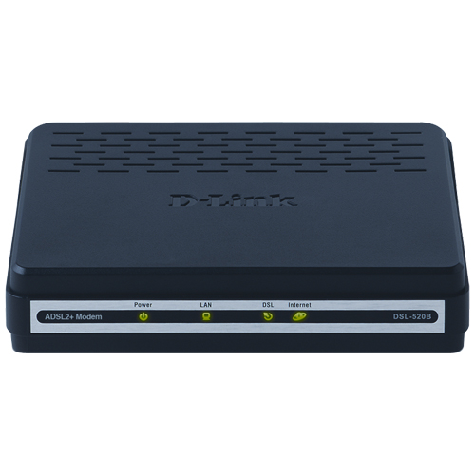
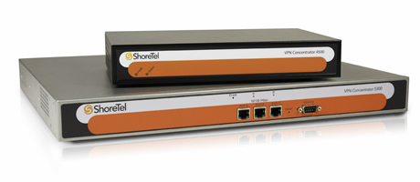
Networking devices: repeaters; bridges; VPN concentrator
Modem
Short for modulator/demodulator.
Converts the digital signals generated by a computer into analog signals that can travel over conventional phone lines.
Can be an internal add-in expansion cards or integrated with the motherboard, external devices
Packet shaper
Bandwidth management technique or device
Used to prioritise certain traffic over others
VPN concentrator
Increases remote-access security
Can create the tunnel and also authenticate users, encrypt the data, regulate the data transfer, and control traffic.

Slide 12
Networking software: Client operating system, Client software
Operating system
Manages hardware and software resources and provides common services for computer programs.
Can be linked to a Networking/Server OS which allows for user login and services access.
Include: Microsoft Windows, Linux(Such as Ubuntu, RedHat, Fedora), Mac OS
Client software
Software that resides on a network users PC.
Could be distributed from the server
Includes: MS Office, Internet Explorer or any that are installed on the OS

Slide 13
Networking software: Server operating system, Server software
Server operating system
Open source, Proprietary, General purpose, Task specific
SOS/NOS include:
Windows Server
MacOS Server
Apache
Linux(e.g Ubuntu Server, RedHat, SUSE, CentOS, Debian, Oracle, ClearOS, Solaris, FreeBSD)
Server software
Antivirus – Symantec Endpoint Protection, McAfee Endpoint Security
Backup Software – e.g Acronis Backup and Restore, Symantec Backup Exec
Roles, services and applications can be installed within Windows Server

Slide 14
Server type: Web, file, database, combination, virtualisation, terminal services server.
By installing and configuring roles within your server operating system you can change the type of server and what it can do:
Web: Server configured to store, process and deliver web pages to clients.
File: Allows resources to be shared between clients on the network. System admin can regulate who has access to what.
Database: Hosts a database which is accessible and modifiable by the clients. Useful for booking or ordering systems.
Combination: Provides multiple services or roles.
Virtualisation: Meaning one physical server that potentially is split into many virtual servers and/or even clients
Terminal services: Allows for taking remote control of clients on the network.

Slide 15
Server selection: Cost, purpose, operating system requirement.
When choosing a server consider the number of clients it will be serving and the type of infrastructure it will be working with.
Consider what type of role the server will be doing.
Blade or rack servers for instance are not necessary in a small home or him business because of cost reasons.
Linux maybe preferable for cost reasons. But are the server admins familiar with the with it?

Slide 16
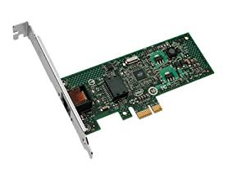
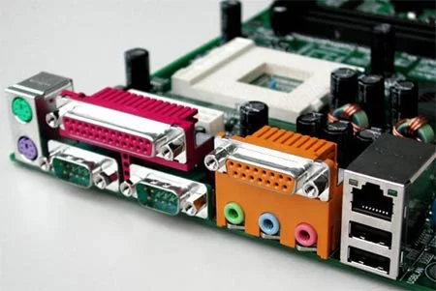
Workstation: Hardware - Network Card
Network card
Enables systems to connect to the network
Can be add-in expansion cards or built-in interfaces.
Data is given to it by the CPU and then sends it to a destination.
Translates the data into a form that can be transferred via cables and then translates the data it receives back into data usable by the computer
Ethernet port on the motherboard indicates network card is built in

Slide 17
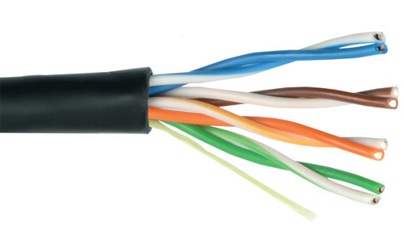
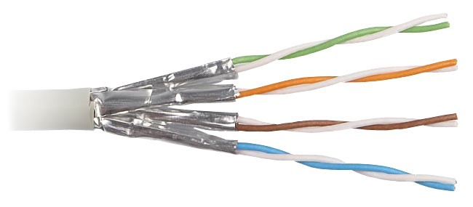
Workstation: Hardware - Cabling
Category | Speed | Use
1 | 1 Mbps | Voice Only (Telephone Wire)
2 | 4 Mbps | LocalTalk & Telephone (Rarely used)
3 | 16 Mbps | 10BaseT Ethernet
4 | 20 Mbps | Token Ring (Rarely used)
5 | 100 Mbps (2 pair) | 100BaseT Ethernet
 | 1000 Mbps (4 pair) | Gigabit Ethernet
5e | 1,000 Mbps | Gigabit Ethernet
6 | 10,000 Mbps | Gigabit Ethernet
7 | 100,00 Mbps | Gigabit Ethernet
Unshielded Twisted Pair (UTP) Cable
Least expensive and most commonly used
Copper cable that consists of 2 to 1800 unshielded twisted pairs surrounded by an outer jacket.
Can experience electrical frequency interference
Quality of cable is graded by category's
Shielded Twisted Pair (STP) Cable
STP cable is the same as UTP but has shielding to electrical frequency interference. Three different types are available:
Each pair of wires is individually shielded with foil.
Foil or braid shield inside the jacket covering all wires (as a group).
There is a shield around each individual pair, as well as around the entire group of wires (referred to as double shield twisted pair).

Slide 18
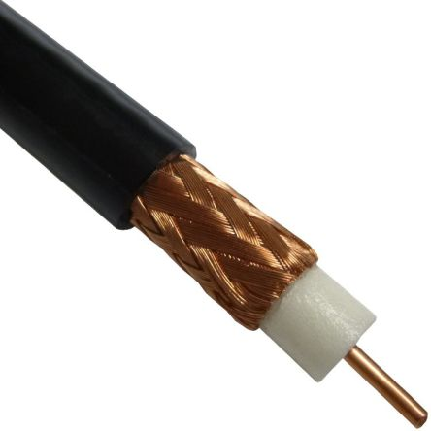
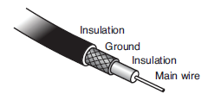
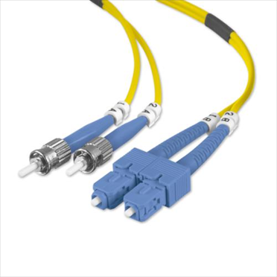
Workstation: Hardware - Cabling
Attenuation
The weakening of data signals as they travel through a medium.
Network media vary in their resistance to attenuation. Coaxial cable generally is more resistant than UTP; STP is slightly more resistant than UTP; and fiber-optic cable does not suffer from attenuation.
Coaxial Cable
Found success in both TV signal transmission and network implementations.
Inexpensive and easy to use
Prone to cable breaks, which increase the difficulty when installing and troubleshooting coaxial-based networks.
Fiber Optic Cable
Addresses the shortcomings of copper-based media. Because fiber-based media use light transmissions instead of electronic pulses
Does not suffer from attenuation
Most expensive but provides higher speeds and longer distances
Cable Max Distances
UTP/STP: 100m
Coaxial: Up to 500m
Fibre: 60 miles

Slide 19
Workstation: Hardware - Permissions
Permissions
Policy management: Through group policy management network admins can restrict user access and service access control within workstations.
Service access policies: Examples include e-mail, file, web and printing. Who needs access to what? Policy's should ensure that only users who need services have access to them
User access policies: Who has access to the network? Users should have username and passwords setup and only access to data essential to their role.

Slide 20
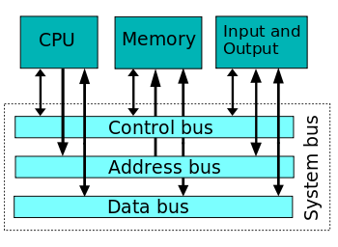
Workstation: Hardware - System bus
Connects the major components of a computer system.
Control bus
Used for the CPU to communicate throughout the system.
Deals with determining what the data does
Communicated to components and through cables to I/O devices
Contains instructions for writing(Sending) and receiving
Address bus
Deals with where data should go
Data bus
Carries data

Slide 21
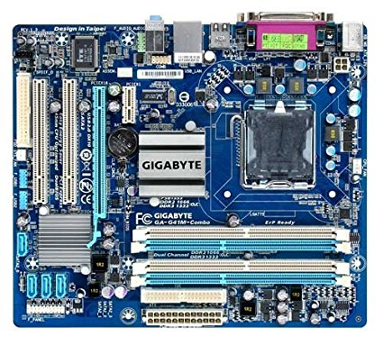
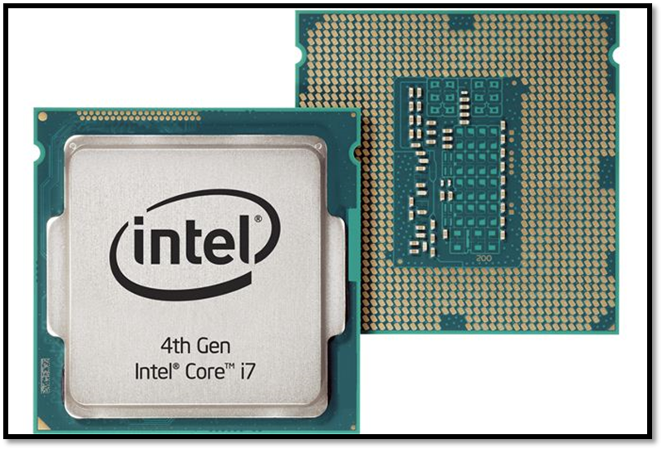
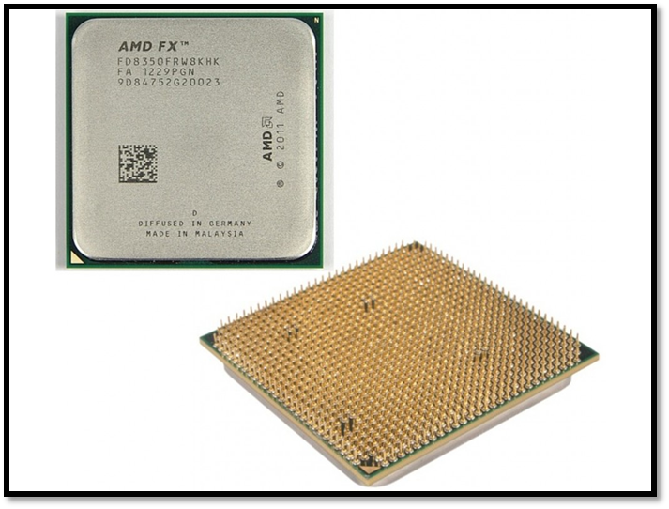
Workstation: Local-system architecture
Motherboard
Holds and allows communication between many of the crucial electronic components of a system. Such as CPU, RAM, Storage along with connections to I/O devices
Processor
The CPU is responsible for executing a sequence of stored instructions called a program.
A CPU has four primary functions:
Fetch: Retrieves the instruction that it needs to run from program memory.
Decode: Breaks the code down to Machine code.
Execute: Calculate extremely complicated mathematical functions and move data from one memory location to another.
Write back: Takes the output and writes it into the computer’s memory

Slide 22
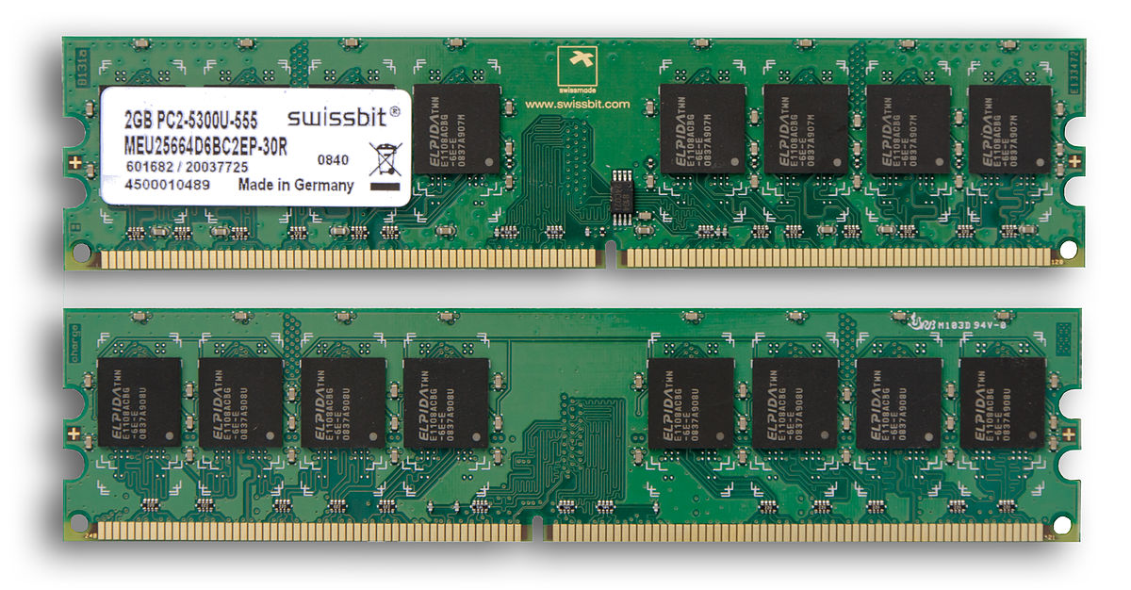
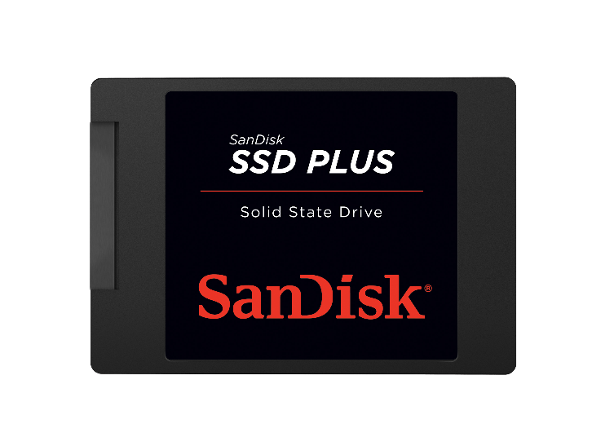
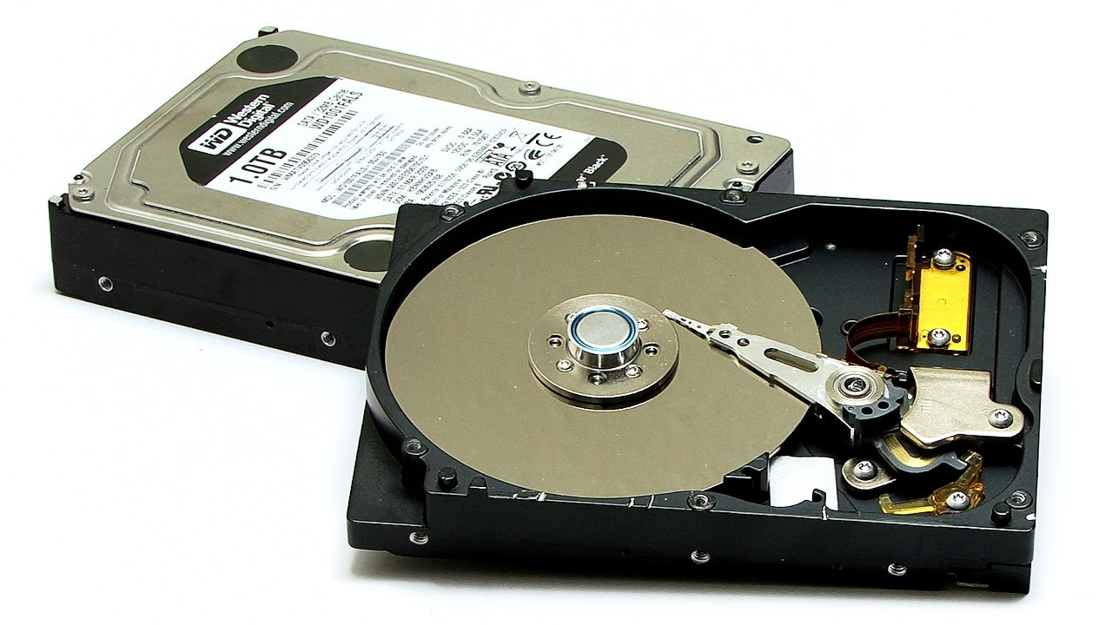
Workstation: Local-system architecture
Memory
Random Access Memory (RAM), is generally what hardware experts mean when they talk about memory. Not Hard Drives, Flash Drives or Cache.
It’s volatile memory that stores information on an integrated circuit used by the operating system, software, and hardware.
Much faster than storage
Storage
Non volatile memory sometimes known as secondary memory. Such as:
Blu-Ray – Single Layer(25GB) & Dual layer(50GB). Speed up to 72MB with 16x Drive.
Hard Drive – Storage commercially available up to 16 Terabytes. Speed of 80-160 MB/s.
SSD – Storage commercially available up to 2TB. Speeds up to around 712 MB/s

Slide 23
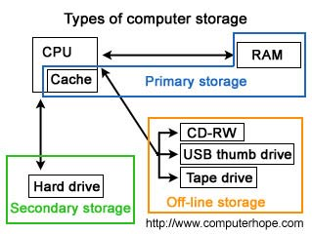
Volatile
Primary Memory
Non- Volatile
Non- Volatile
Storage

Slide 24
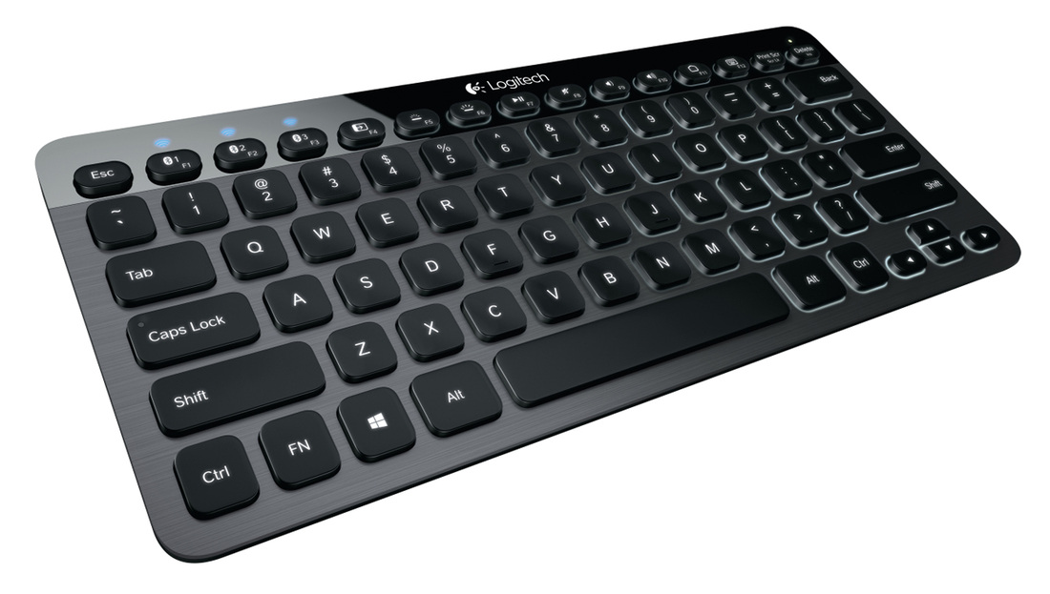
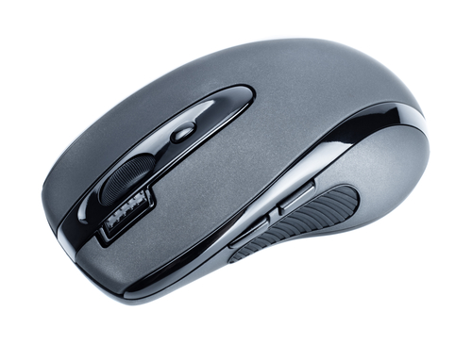
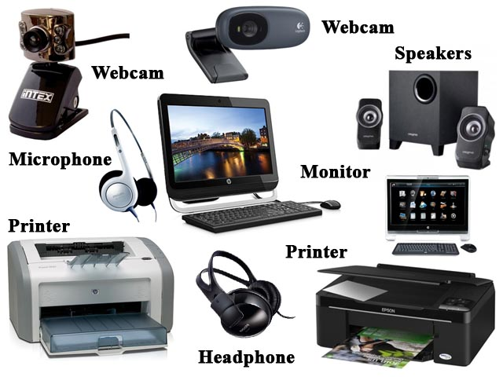
Workstation: Local-system architecture e.g. memory, processor, I/O devices.
Input devices such as:
Controllers
Keyboards
Mouse
Scanners
Output devices such as:
Monitors
Speakers
Printers

