Slide 1
Unit 5 Assignment 1
Help

Slide 2
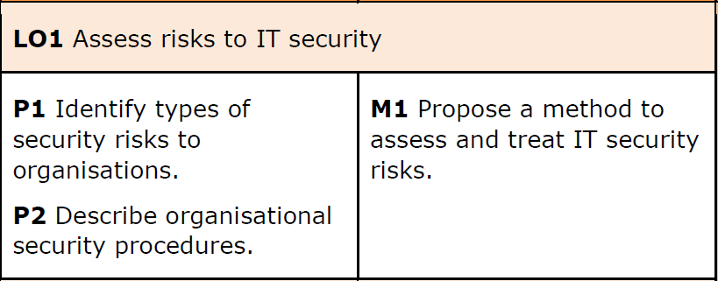

Slide 3
LO1 Covering P1 + P2 Cover as much as possible
LO1 Assess risks to IT security. IT security risks:
Risks:
Unauthorised use of a system; unauthorised removal or copying of data or code from a system; damage to or destruction of physical system assets and environment; damage to or destruction of data or code inside or outside the system; naturally occurring risks.
Organisational security:
Business continuance; backup/restoration of data; audits; testing procedures e.g. data, network, systems, operational impact of security breaches, WANs, intranets, wireless access systems.

Slide 4
Proposing a method to assess and treat IT security risks. (M1)
Establish a risk management framework
Outline how you would identify risks, who’s responsible, the impact to the business and how likely it is to occur. Baseline criteria, Scale of risk, Acceptable risk(Risk appetite)
Identify risks
Create a list of business assets such as files, media, portable devices as well as content such as Intellectual Property.
Analyse risks
Identify threats and vulnerabilities to each asset
Evaluate risks
Order security risks from high to low
Select risk treatment options
Define exactly who is going to implement each control, in which timeframe, with which budget, etc.
Research:
ISO 27001 risk assessments
(ISO = International Organization for Standardization)

Slide 5
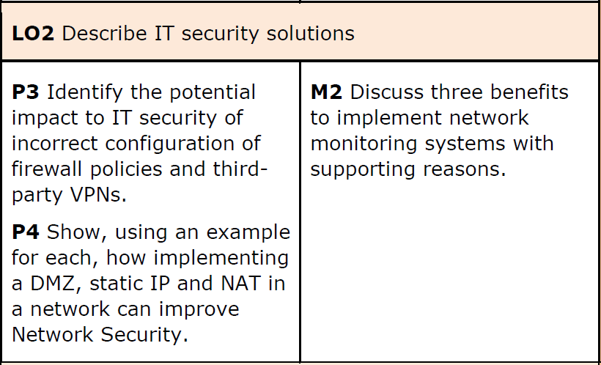

Slide 6
LO2 Covering P3 + 4 Cover as much as possible
LO2 Describe IT security solutions. IT security solution evaluation:
Network Security infrastructure: evaluation of NAT, DMZ, FWs.
Network performance: RAID, Main/Standby, Dual LAN, web server balancing.
Data security: explain asset management, image differential/incremental backups, SAN servers.
Data centre: replica data centres, virtualisation, secure transport protocol, secure MPLS routing and remote access methods/procedures for third-party access.
Security vulnerability: logs, traces, honeypots, data mining algorithms, vulnerability testing.

