Slide 1
Unit 40 - User Experience & Interface Design
Session 1 - Introduction

Slide 2
Unit Introduction
User Experience (UX) and User Interface (UI) Design is the process by which software applications and user interactions can be designed to be simple, accessible, effective and attractive for the end user.
The objective of UX and UI Design is to create user interactions and software application experiences that are appropriate for specific platforms or devices and provide desirable end user outcomes utilising insight and understanding about the practical, emotional and experiential motivations and values of the end user.

Slide 3
Topics included in this unit are:
Classification and terminology of UX and UI Design techniques
Relationship between UX and UI Design
How UX and UI Design relates to the rest of the software development lifecycle,
Understand a user’s emotions, desires and attitudes about using a particular feature, product, system, platform or software application.
Modes of interaction, human-computer interaction models,
Usability, accessibility, aesthetics, design thinking, value proposition design,
User journey mapping and gathering meaningful insights from users feedback and research.

Slide 4
Learning Outcomes
By the end of this unit you will be able to:
LO1. Research what aspects of User Experience and Interface Design are necessary and appropriate to satisfy end user emotions, desires and attitudes when using a user interface concept.
LO2. Plan an appropriate User Experience map and Interface Design for a User Interface concept with a specific target end user in mind and also outline the tests you mean to conduct.
LO3. Build a User Interface concept and test it with users to see if it satisfies their emotions, desires and attitudes as planned.
LO4. Evaluate user feedback, test results and insights gained from end users interacting with your User Interface concept to determine success or failure and steps to improve in future versions.

Slide 5
Assignments
Assignment 1 – Research report into User Experience
Assignment 2 – Plan and build a User Interface Experience
Assignment 3 – Evaluate a User Interface Experience

Slide 6
What is Design?
“Most people make the mistake of thinking design is what it looks like. People think it’s this veneer –that the designers are handed this box and told, ‘Make it look good!’ That’s not what we think design is. It’s not just what it looks like and feels like. Design is how it works.” Steve Jobs

Slide 7
Todays objective
Understand what user experience (UX) means and how it matters
Understand how to approach UX and usability
Understand how to approach UI design

Slide 8
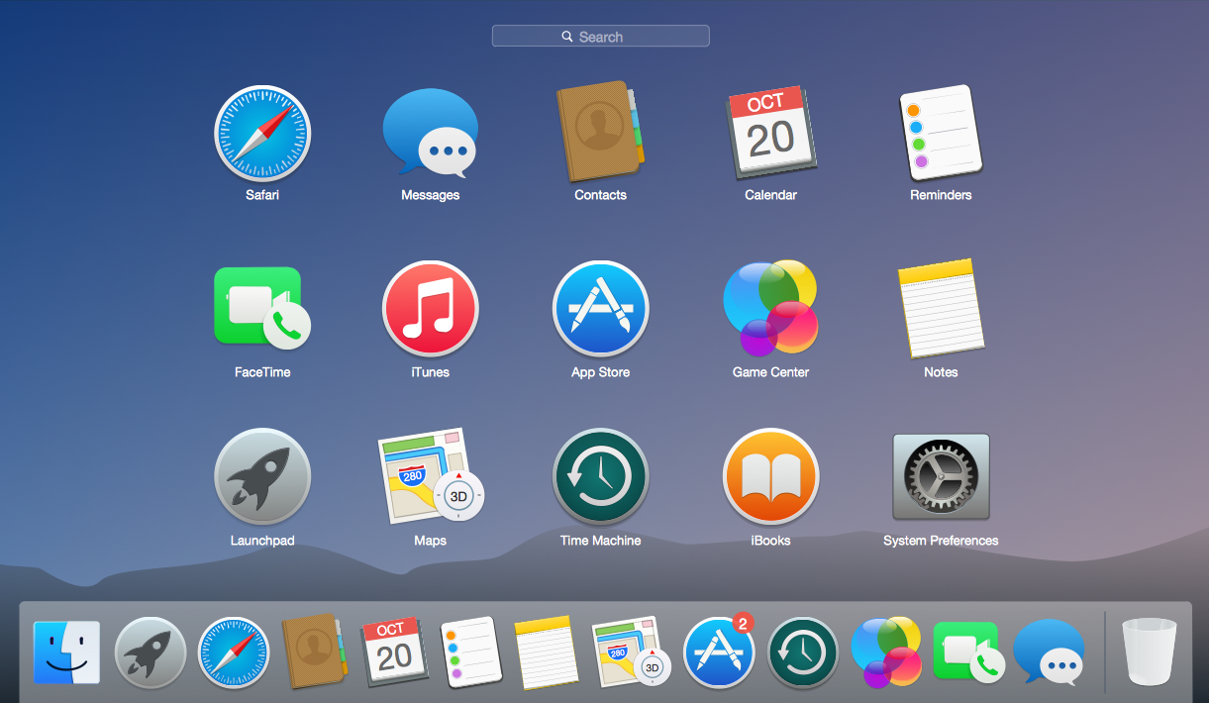
WE ALL EXPERIENCE USER INTERFACES

Slide 9
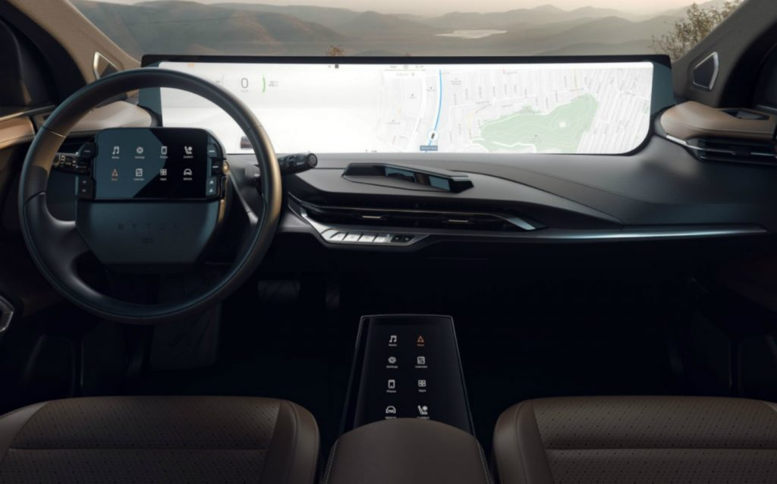
USER INTERFACES OF A DIFFERENT SORT

Slide 10
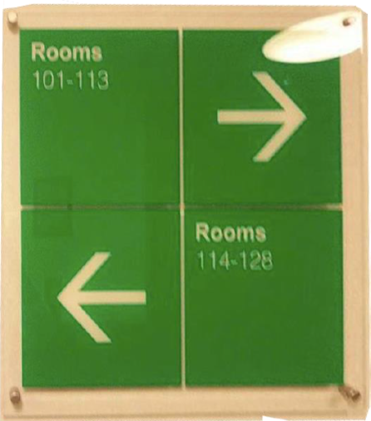
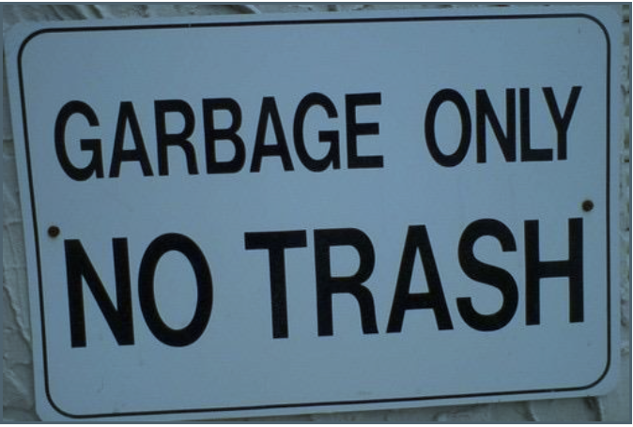
Some designs are confusing…

Slide 11
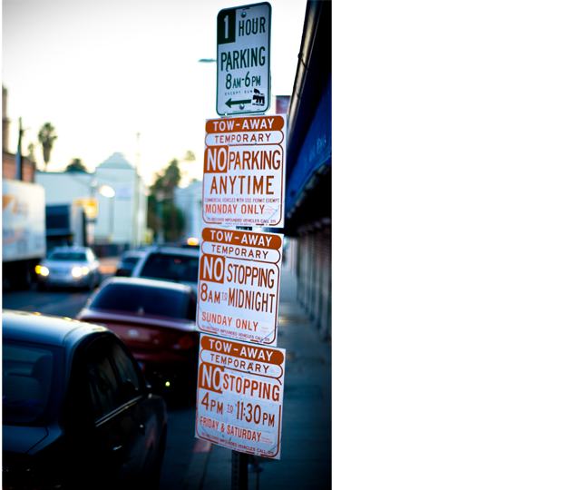
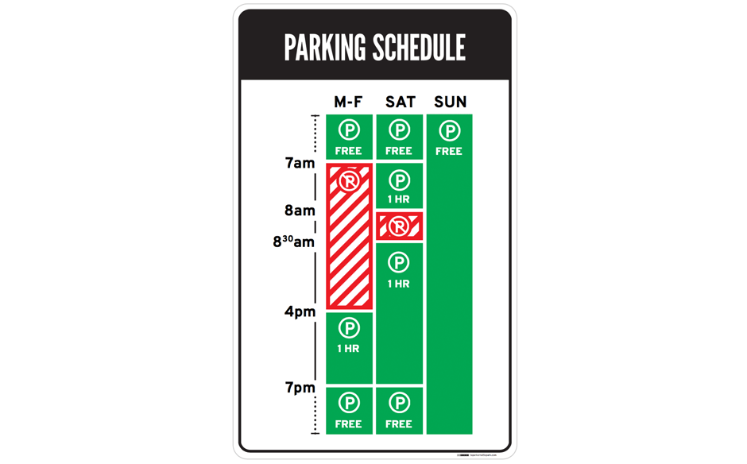
Compare:

Slide 12
So what is User Experience (UX)
Puts the end user at the centre of universe and defines the system from that perspective.
Usability is finding the best match between a user’s needs and a product’s use
While this is a specialty by itself, a computer scientist/developer can grow an appreciation for UX, which affect:
Functionality
System Organisation and Structure
Interactions and Look and Feel
Access

Slide 13
So what is User interface (UI)
In order for computers to be at all usable, they must be controlled through a UI.
UIs act as bridges between human logic and computer logic.
While User Experience is a conglomeration of tasks focused on the optimization of a product for effective and enjoyable use, User Interface Design is its complement visual/graphic presentation
A digital field, which includes responsibility for cooperation and work with developers or code.
Notes:
“Your app looks great(UI) but the User Experience is terrible! “

Slide 14
Quick look at the Windows UI
Important information is displayed at all times through the status bar.
Including time, volume, battery status, background apps, and notifications (whether messages, or system errors).

Slide 15
Windows App Launcher
Pop up still allowing view of the desktop or current app
Selection of squares designed to be easily clicked or touched

Slide 16
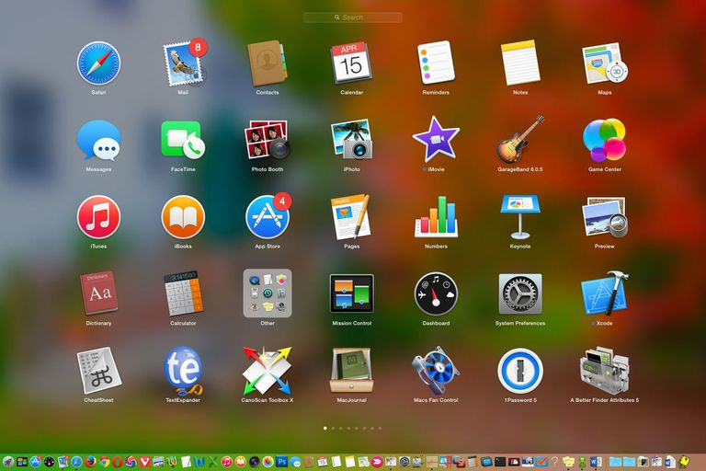
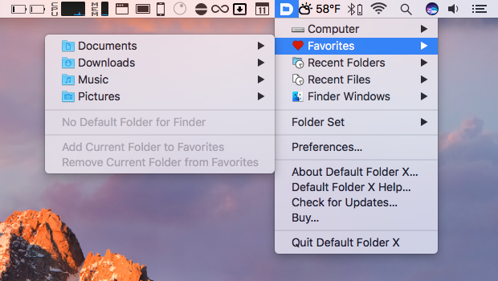
Quick look at Mac OS
Large app icons which are more focussed taking the entire screen.
Status bar at the top displaying important information.
Windows vs Mac OS – Different takes on design but both examples of good design practices

Slide 17
Good UI/UX Design Takeaway
Understand what your users need, then deliver that information.
If you’ve got lots of information to convey, try using visuals instead of text.
Always label your links! Users don’t like mystery links.
Avoid adding any kind of friction to user actions, unless they’re meant to dissuade the action.
Test your clever designs and include them cautiously.
Animation is like cursing. If you overuse it, it loses all its impact.

Slide 18
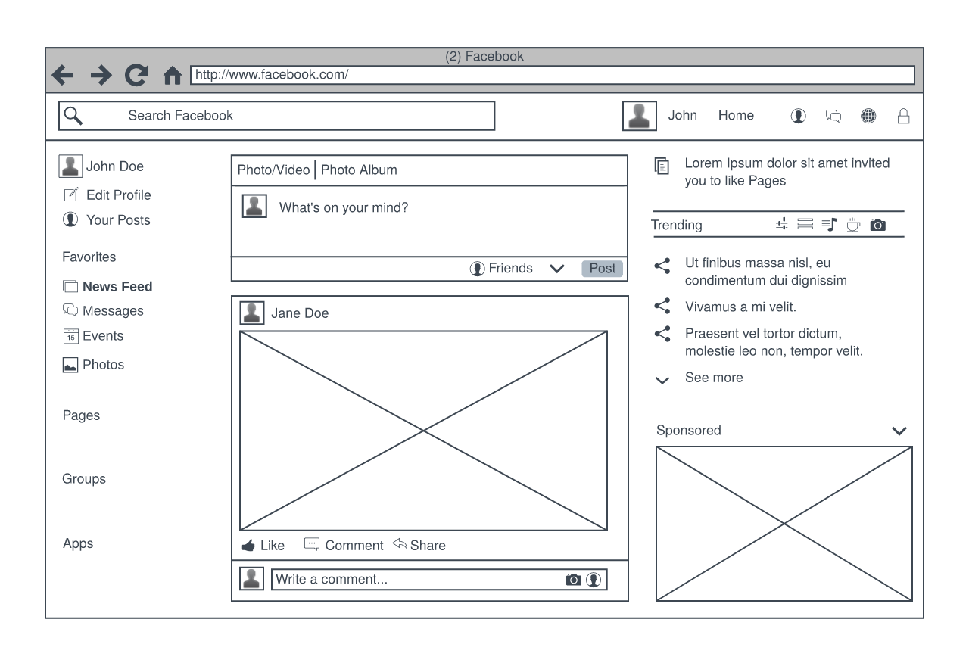
Task – Evaluate a user experience
Hand draw or use a tool such as LucidChart/Pencil
Teams of 2:
Choose a favourite software application, service or product (e.g. email, Facebook, Dropbox) and create a drawn wireframe version of its user interface.
Evaluate the user experience in simple terms, i.e. is it effective? Could it be improved? What are its shortcomings?
Answer the question: How would you test it with users to elicit feedback?
Notes:
Teamwork: Student teams choose a favourite software application, service or product (e.g. email, Facebook, Dropbox) and create a drawn wireframe version of its user interface evaluating the user experience in simple terms, i.e. is it effective? Could it be improved? What are its shortcomings?
Tutor-led/facilitated group discussion with the class about the wireframes created by students. Each should answer the question: How would you test it with users to elicit feedback?

Slide 19
Next Week
A greater look at the purpose of UX and UI
The types of UX and UI
The different roles within UX and UI

